Slide 1
Gateaux & Turkey-Twizzlers School Direct and Traditional PGCE students’ perceptions of university-led and school-led mathematics teacher education
Dr Sally Bamber
s.hughes@chester.ac.uk
AMET Conference 3rd October 2015

Slide 2
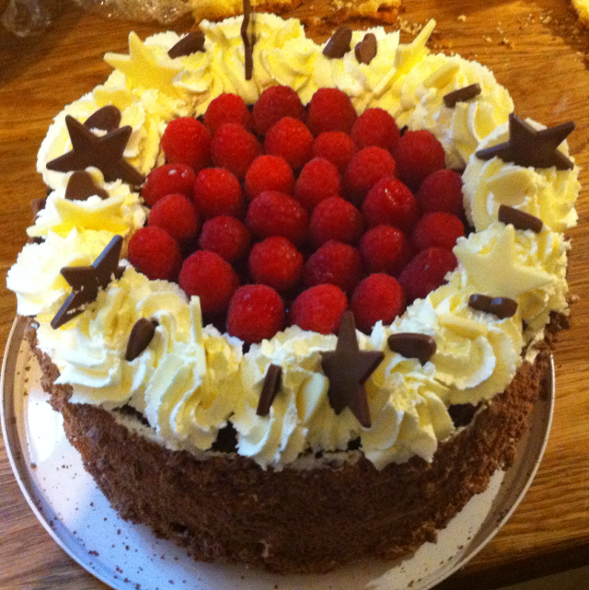
Mentor says to ITE student
The lesson ideas that you get from university are great but they are very rich- like Gateaux. You can’t have gateaux every day. Your lessons need to be like fruit-one of your five-a-day.

Slide 3
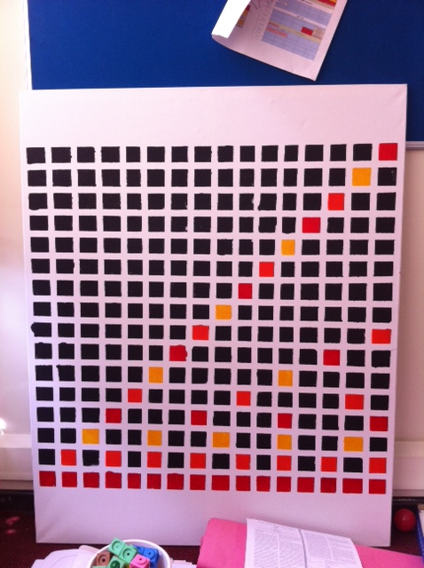
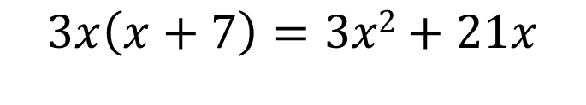
University Tutor asks ITE student
Is that Gateaux?
Yes, we all agree that this is Gateaux.
But what about this?
No, that’s not gateaux because you can tell the pupils what to do.
$$3x\left(x+7\right)=3x2+21x$$
But what if you wrote this relationship on the board and asked the pupils whether it is true or false? Or if it is true for all values of x? Or if they can convince you that this relationship is true using words/images/symbols?
Yes, that’s gateaux because it’s the way my mind works.

Slide 4
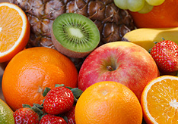
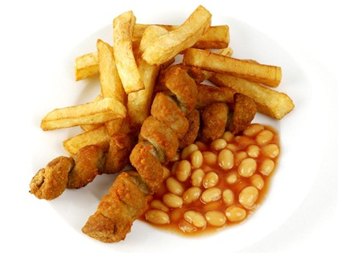
University Tutor shares the metaphors with another mathematics teacher educator
… but what they are serving in school is not fruit.
…. It’s more like Turkey Twizzlers. Its masquerading as food, but it’s actually, in the long term, not very good for them…

Slide 5
What’s your interpretation of the Gateaux Lesson that Anita talked about?
It worried me. It just… I don’t know it just makes me panic. Because I probably feel like my lessons aren’t even like the basic normal ones. I sort of saw where she was coming from, in a way, but then I didn’t agree with everything that she said, I don’t think. I suppose her idea of a gateaux lesson and my idea of a gateaux lesson would probably differ, which I kept going over and thinking she’s probably got an idea of what her gateaux lesson would be like. But… She thought its okay to have one of those a week, but my idea of a gateaux lesson is not the same as hers and I would do it more often. (Rachel)
I kind of understood it as that perfect lesson that lesson that 10 out of 10 outstanding on everything sort of lesson, where the kids go out of the classroom, big smiles on their faces because they feel enlightened in some mathematical topic. (Sam)
… and they’ve done it by themselves as well. Rather than you just telling them how to do something they’ve done it by themselves, like independently. (Rachel)

Slide 6
Have you seen any Gateaux Lessons in school?
No I don’t think that I have seen [rich lessons], not in the sense that I kind of imagine the sort of rich tasks that you do with us that sort of build our understanding right from the very bottom… that I see fitting into a proper gateaux lesson. That’s what… I wouldn’t say I’ve seen any of that. Maybe it’s because you don’t need it all the time. (Sam)
Possibly the other way around. I was teaching sequences with one class and I was teaching them to consider which times table it’s based on and how the sequence moves [up and down the number line] and the teacher said to me at the end of the lesson, why didn’t you just teach DNO. I was quite shocked because to me DNO is just a way to do it and they don’t understand that the sequence is based on a times table and they don’t understand why they do it. They don’t understand why they’re doing it, they just have to write numbers in that order. (Sam)
I think she thought I could have got through what I got through in that lesson a lot quicker if I’d just done DNO. She felt I could have packed a lot more into that lesson. I think it took them longer to grasp what they were actually doing and why they were actually doing it, but I like to think, in the long term, it’s going to stick with them a bit more. (Sam)

Slide 7
Am I misguided in teaching you in the way that I do?
No. Because we’re learning. And we’ve, even though they’re not our classes we’ve still got to try to be the teacher that we want to be. We’ve still got to get something from it. (Rachel)
And you’re under similar time constraints that we’ve got. You’ve only got a year to get us… to train us to be at that level. If you had two years, maybe the first year we could spend just teaching these normal lessons in the classroom and maybe the second year we could introduce these more gateaux lessons. You’ve got to pile it on all at once, all the different techniques and all the different things we need to be looking at. (Sam)
It is difficult… it’s so much easier just to tell them…. And the pupils sometimes say ‘just tell me what to do’ and… ‘Is it in the exam’. (Rachel)

Slide 8
Can you think of any examples of lessons that developed relational understanding?
Probably… the Farmer Jo one for my assignment. There were a few who found out by the end how to find the [maximum] area of the rectangle. They had the length, the width and the area and they saw the relationship between those three numbers… yes and they could relate the [repeated rows] to the area because I’ve used the array… because their times tables are not very good. I’ll do 8 dots 4 times for 8x4 and I think that helped as well because they were familiar with that. (Rachel)
And that was a mistake I made on first placement that [my mentor] picked up on because it was area of a triangle and it was Year 8 set 1 so I just thought, well tell them length times width divided by two and it would be fine, but there were a couple that just didn’t get it. Instead of drawing out the rectangle… I was just… I thought just put the numbers in, it’s not hard. I wouldn’t even dream of doing that now, it’s just not logical. It’s only because [my mentor] told me afterwards, I knew straight away as soon as he said, oh yeah why didn’t I just draw out the rectangle around it so that they could see that it was half. (Rachel)
When I spoke to [my mentor] afterwards. It just made me think about it in a different way and I couldn’t believe that I hadn’t thought of it like that. (Rachel)

Slide 9
Does the absence of deep, conceptual understanding effect you?
Yes. I’ve been frustrated if I’ve got a Year 7 class and a Year 8 class and they’re at the same place in the scheme of work and I end up teaching essentially the exact same lesson to Year 8 as I did to year 7. And it’s like, well if the teacher did this with them last year, why am I having to do it all over again? (Sam)
I wonder if that’s what it is with all pressures of, you know, keeping up on marking and writing kids’ reports and having to monitor so many other things about them, then planning maybe takes a back seat and the teachers just pick the thing that is quick and easy. (Sam)
It’s just easier. It sounds awful but it is just easier. (Rachel)
I think it’s… that if you don’t do something for a long time, it does get pushed to the back of your mind. Like I said before, with all the pressure planning is pushed to the side. (Sam)

Slide 10
Am I wrong to teach you in a way that conflicts with your school experience?
No. You’ve got to. I only understand algebra because of what we’ve done with you. Before I would do this do that, bang in this and get an answer. Now I know why it all works and how it fits together. (Rachel)
Sometimes you’ve got to realise that the idea of it and how it pans out in the classroom is not the same. (Rachel)
I would never on something like this [3x(x+7) = 3x²+21x] say this means times and do this and that and that. I would get the kids to tell me what it means and tell me what they already know about it. I wouldn’t use [a transmission model] directly. Sometimes you see it in a class that are only a few weeks off their tests and you know it’s almost like the only way to get a short term result is just to tell them what they need to do so that the following week they are able to reproduce it in their tests. You don’t have that time to go back to the beginning and build all the layers up from the bottom. (Sam)

Slide 11
Tell me more about school and university.
I’ve felt all the way through that I’m in two parallel universes. There’s the kind of breakneck pace of being at school and the kind of methodical, thoughtful, analytical pace of being at university and… it’s hard to see where there’s a connection between the two. You’ve got that sense that the two universes are running in parallel and we have this occasional link across from the one to the other but... the two are… they feel disconnected. (Adam)
For me seeing you in the school context at the enrichment week was... wow… I didn’t realise… it feels odd because suddenly you’re in the school situation. Maybe in the early days trying to have some kind of activity that stops the two from feeling like two separate worlds… and it feels weird... because we see you out of context. (Adam)
What would be fabulous is seeing some of those techniques that you’ve shown to us- watch you do some of those in the classroom… I remember a time here where you ran through [a model for learning algebra] and said this is a great way to teach this and okay we’re taking that on and trying to remember aspects of that…. To watch you do that with the kids. Because I got the chance to see you do a chocolate thing in the combined art maths class. And we’re going back a long time now when I had two or three days observation at [a partner school]. And I saw you in the classroom with the kids doing the chocolate thing, doing the factors. That was, for me, watching you teach the kids… so that you have credibility is an issue. I watched you do it with those kids and I saw how effective it was… and when you’ve done anything since I am not sceptical. I have complete trust and confidence that what you are explaining will work, will work in the classroom. I don’t have the same trust and confidence when I am with [other tutors]. (Adam)

Slide 12
How could your experience be improved?
What you need to do is you need to have a debate… the debate where you are in the room and the mentors, teachers from school are in the room and one or two others are there and we say, let’s be honest about the spectrum of different activities and lets just get that onto the table. The worst scenario is that everyone is very lovely to your face and when you go they say forget about that. The worry is if there’s an element of that. I think people have very high regard for you, but I have high regard for [my first mentor] and I didn’t like his style. Therein lies the problem, they can preface their comment with Sally’s great at what she does. Then you know there’s a but coming. No buts let’s get the debate on the table. A debate about teaching philosophy between you and [the mentor] and other people, let’s bring it on. We couldn’t have that at the start, that would look like warring parents, but there must come a point in our training when we can have that debate. There’s room for lots of different styles. The one thing we must guard against is the university tutor coming along and then leaves and everyone has a pop. There’s some big stuff there. (Adam)

Slide 13
Where are you up to now?
Going back to something you said today, it wasn’t until you saw me at [my second placement school] that we built up a relationship enough for us to be able to have a two way conversation and for me to be receptive to what you are saying. I think for a bit at the beginning… and even sometimes now, there’s still an element in my mind that feels ‘is she brainwashing me? She’s still trying to brainwash me. There’s some kind of cult thing going on here that I’m not party to’. I haven’t quite accepted this invitation to discovery-led learning. It’s not quite my thing. I get the idea of constructed and of connected and making it real. But it hadn’t quite connected in my mind as to what the whole discovery thing was and discovery meant less control and there was a resistance there. (Anna)
There has been… some separation sometimes between what we’ve done here and what you see when you go back. And I think in general there is a resistance to the way that you’ve brainwashed us and culted us into thinking. And we’ve all questioned ourselves, we’ve all come back and said ‘why is it we’re not seeing what we’re talking about here in schools?’ and you know… we’re wiser now to know that it’s because teachers tend to fall into the easy category and teaching connected is not easy. (Anna)
… and even though [teachers and mentors] might be a convert here… as soon as they get back into school other pressures take over and you revert back to type. And you often do see that. I think they all aspire to what you are saying but it just… it feels like a pipe dream. There are other pressures that you can’t possibly plan for… this is reality. (Anna)

Slide 14
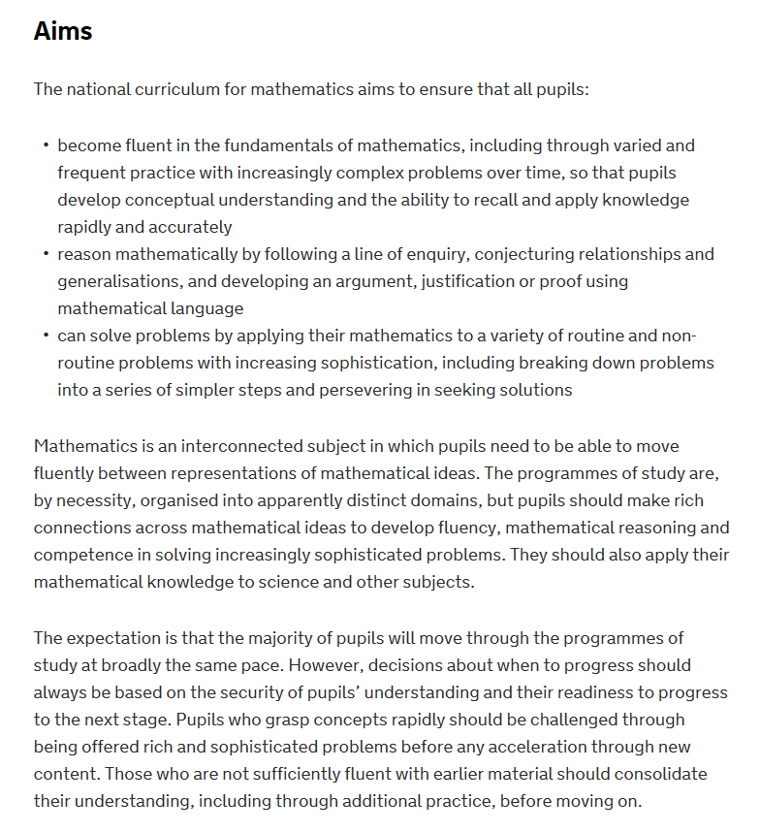
DfE, 2014

Slide 15
The best teaching develops conceptual understanding alongside pupils’ fluent recall of knowledge and confidence in problem solving.
Too much teaching concentrates on the acquisition of disparate skills that enable pupils to pass tests and examinations but do not equip them for the next stage of education, work and life.
Ofsted, 2012 Made to Measure

Slide 16
To teach students theory is in some degree to anticipate their needs, and one must try to ensure that the seeds scattered during training retain their power to germinate after two to five years of teaching, at which point the teacher begins to need them if he is to develop further. The only way in which the theorist can meet these difficult requirements is by attempting to build up a culture centred on the classroom. He must try to produce theory which articulates the values, understandings and information and techniques which support various approaches to the work of the classroom. Such theory allows the teacher to act independently and creatively.
(Lawrence Stenhouse, 1967)

