Slide 1
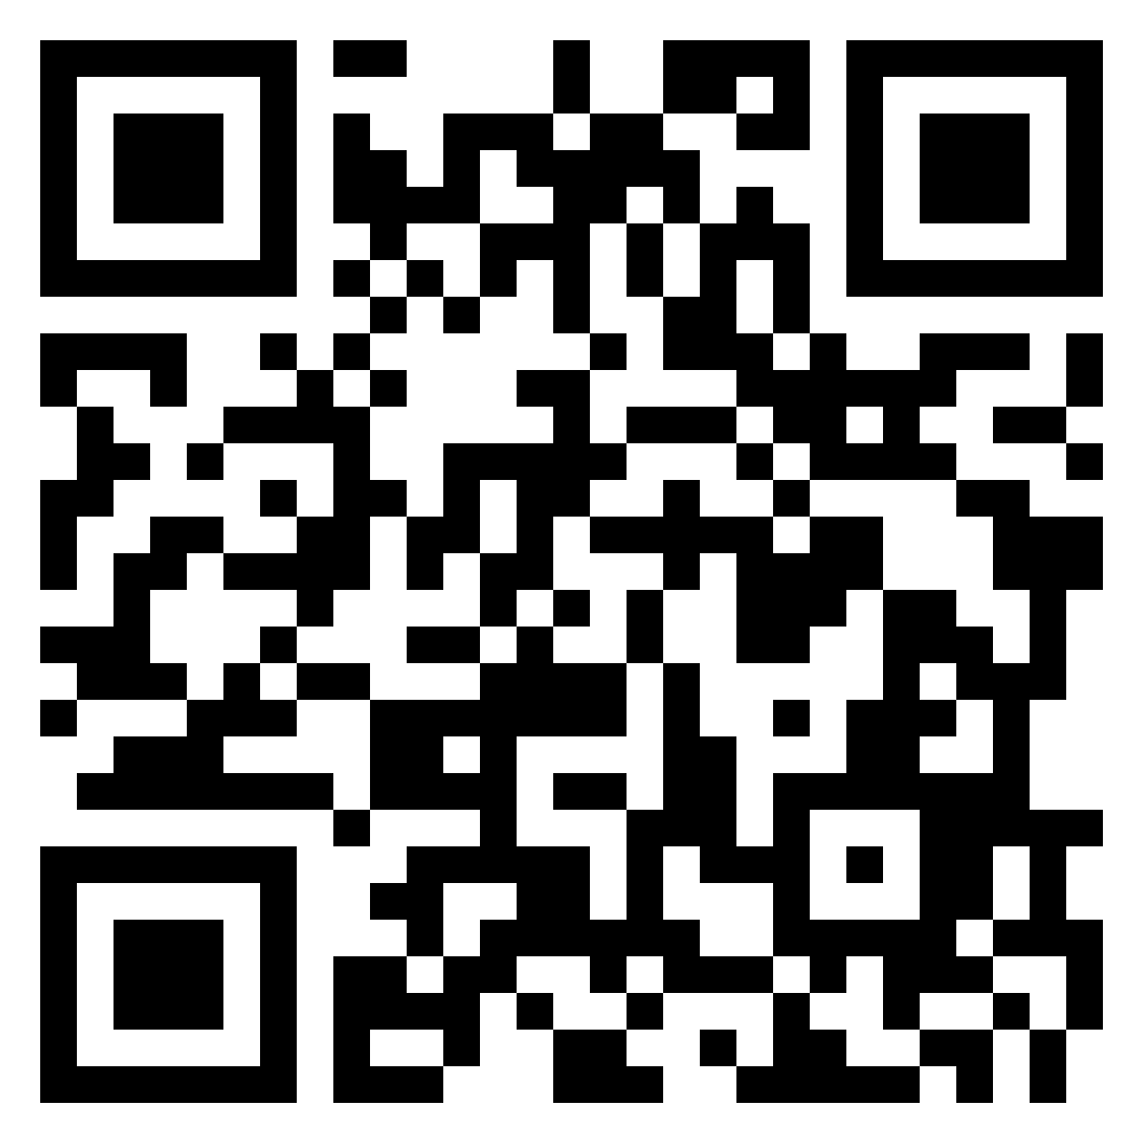
Shaping up as new Initial Teacher Education maths tutors
Karen Gladwin, Ashley Compton & Fiona Curtis
April 2024
https://uofsussex.padlet.org/kagladwin1/amet-considers-induction-np81xwo820d9ywcq

Slide 2
Background
Request at 2023 AGM
No nationally stated standards for Teacher Educator (TE) professional knowledge (unlike Netherlands & USA)
10 year cycle of activity
BSRLM + ATM, AMET and ATM working group in 2003
Questionnaire to help define the research question and subsequent interviews (not yet done)
Notes:
TTA grant to AMET, ATM, BSRLM and MA to produce materials and provide induction support (induction events) following concern re suitably qualified ITE and CPD providers – lower pay than school teachers, HE funding struggles
Pope et al., 2003 – transfer of resources to schools introduced temporary hourly paid staff, intensification of work, bureaucracy and supervision, less research.

Slide 3
Focus points for Teacher education induction
Interviews with new English TEs found five areas of need:
Pedagogical/andragogical knowledge for HE
Generalisation of school-based knowledge eg national policies
Developing researcher identity
Developing ways of working with school-based colleagues
Pragmatic knowledge of institution – bureaucracy, size and disempowerment
Murray & Male, 2005
Notes:
Pedagogy – construct and deliver lectures, manage discussion-based learning not transmission, what/how/WHEN to teach
Research difficult to reconcile with busyness of school work, initiatives, Ofsted, no sense of symbiosis

Slide 4
Pedagogy and Andragogy
 | Pedagogy | Andragogy
Dependence | Dependent | Independent
Reason for learning | Required; progress to next stage | Need to know; Need to develop skills
Motivation | External > internal | Internal > external
Role of learner experiences | Considered limited | Have wide range
Role of teacher | Focus on what Selects the content; designs the learning process | Focus on how Providing resources; guiding and supporting
Notes:
Is teacher pedagogy enough?
Is teacher pedagogy enough?​
Simmons and Back (2014) say you need to consider andragogy​
Knowles et al (2011) developed the theory of andragogy – but later conceded that pedagogy – andragogy is more of a continuum and all can apply to children and adults at different times / contexts​
Merriam, S. & Baumgartner, L. (2020). Questions andragogy; They discuss other theories of learning that relate to adults, ​
*such as McClusky theory of margin, balancing load (external load: adults have a lot of responsibilities beyond the classroom, e.g. work, caring commitments, internal load: self-concept; goals; expectations) and power (physical: health, stamina; social: ability to relate to others; mental: ability to think and reason; economic: money, influence; skills: what they can do) ; Critics say this is not a theory of learning but the conditions necessary for learning.​
*and Mezirow psychocritical approach of transformative learning – this involves 4 stages: experience, critical reflection, reflective discourse and action. It makes the learner more critical of others but also examining own assumptions and beliefs.​
Rieg & Helterbran (2005) They disagree and say that many teaching skills are the same for children and adults

Slide 5
Study (Phase 1)
Questionnaire sent to AMET members and other contacts involved with mathematics ITE
23 responses
How long in ITE?
HEI or school-based?
What sector?

Slide 6
Findings - Qualifications
Q1
Virtually all were required to have QTS, postgraduate qualifications held by some but not generally required.
Only 5 had QTS alone – most had joined ITE in last 3 years
Notes:
Fiona
Consistent with Boyd et al. (2011) almost always appointed from school background, variation in institutional expectations about research/publishing
Not known what institutional requirements were, rather than what incumbent had. Straw poll in the room

Slide 7
What was your induction experience when starting in ITE?
 | EY/Prim | Multiple | Sec
Negative | 0 | 1 | 4
OK | 2 | 1 | 1
Positive | 9 | 2 | 3
No negative experiences for Primary colleagues
mixed experiences for secondary colleagues
Experience v Sector
Notes:
Karen
Q8
5 negative or no mention of actual induction
4 ok or mixed between uni and dept

Slide 8
What was your induction experience when starting in ITE?
 | <3yrs | 3-10yrs | >10yrs
Negative | 2 | 2 | 1
OK | 1 | 1 | 2
Positive | 2 | 3 | 9
Experience v Length of Service
The longer a tutor, the better the induction
Notes:
Karen
A study by Czerniawski et al. (2017) that looked at 1158 ITE tutors in HE across six countries found the tutors were only moderately satisfied with their experiences of induction and professional development.
Czerniawski et al. (2017) said that there are five important things to consider when addressing induction needs.
more time for research, discussions with colleagues, introduction into new pedagogies and ideas
Development of research skills both locally and internationally
supporting the use of ICT with courses and training especially in areas like social media
Initiating the publishing of research, and then later in a career, help with increasing the rates of publication
Consideration of pedagogies, principles and delivery leading to upskilling of general generic teaching

Slide 9
Positives
Negatives
Working as team or in close contact with a colleague
Assigned a mentor or buddy
Sharing resources and shadowing colleagues
Encouraged to explore the role
Gradual process eg mentor, associate tutor, part time
No/none/little induction
Nothing provided by the university that was relevant to role
Baptism by fire
Notes:
Karen
I think this spread of ideas ties in with Murray and Male's (2005) thoughts that it takes a novice teacher educator up to three years to acclimatise to the expectations, roles and forms of professional knowledge associated with working in HE.

Slide 10
Things that helped settle into role
Mentored trainees previously
Having a masters
Doing a PG cert (PGCAP)
Online handbook
Notes:
Karen
When moving from school to university Braund (2015) identified from literature, four transitional fears
uncertainty with new professional roles ( Boyd and Harris 2010)
the nature of adult pedagogy (Murray and Male 2005; Loughran 2006)
Fears in relation to the adequacy of professional and academic knowledge bases ( McKeon and Harrison 2010)
the relative absence of collaborative working environments to facilitate reflective workplace learning(Eraut 2004; Harrison and McKeon 2008)

Slide 11
In the first three years, what did you find enjoyable about being an ITE tutor?
Working with enthusiastic trainees and having influence on their development.
Working with schools/mentors - shared aspirations for best practise
Colleagues
Course development
Research/scholarship
Trust and flexibility
Notes:
Karen
Working with trainees was mentioned in many people's responses. Being able to see them grow both as maths teachers and individuals came across strongly. Working on techniques together while noticing the connections and beauty in mathematics, seemed as important as challenging their beliefs on teaching. There were mentions of energy, passion, and enthusiasm. And with reference to working with undergrad students in their first year of training and it being a little akin to working with teenagers!
And even mention of working on critical writing with the trainees which is a challenge for many of us, I’m sure!
People spoke of working with schools to supporting placement experiences and the progression of mathematics education. Working with mentors to make sure that pupils had at least competent and ideally inspiring teachers in their maths classrooms.
Great colleagues and teamwork were mentioned along with sharing ideas both inside and out of home institutions.
Tutors enjoyed the academic freedom (now gone?), planning their own curriculum and writing new session content.
Research was mentioned by a few who talked about having time to developing their own understanding of mathematics education research and making links with other educators.
There were several mentions of things around flexibility and the variety of work in ITE, being trusted to get on with things, and more freedom than in a school classroom.
This points across a range of aspects that we face as ITE tutors and ties in with Laudel and Glaser's (2008) work that suggests that being an academic involves 3 different careers in one: a cognitive career involving research and the publication of articles, a community career and for teacher trainers I guess the community includes our departments and our partner schools and a organizational career where employees perform according to the requirements of their institution.

Slide 12
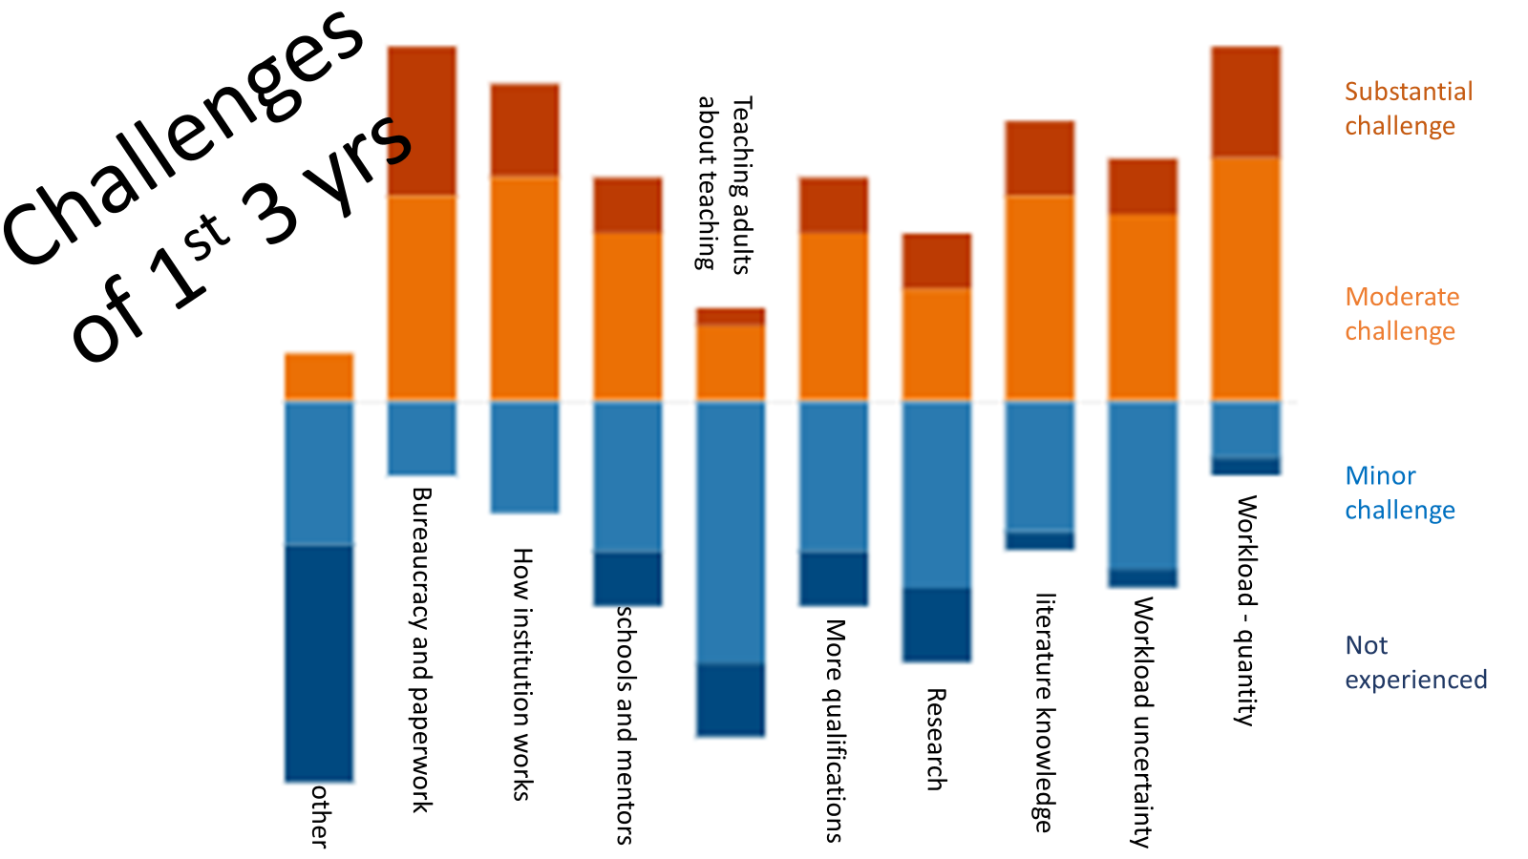
Notes:
Karen
I don’t think any of us are surprised to see that the quantity of workload alongside bureaucracy & paperwork lead the way in the challenges colleagues faced in their first three years. Followed closely by having to navigate how the new institution worked. Is this different to changing schools? What was nice to see was that teaching adults (not pupils) & teaching about teaching weren’t seen as major issues. (Although I have to say I personally miss teaching straight maths – now my SKE is asynchronous.)
"Other" was indicated as 3 minor and 1 moderate, but the majority of who replied (not everyone did) said not experienced … I am intrigued… so we will follow this up when we interview and see if we missed any key areas.
The variability in teacher educators roles is well documented (for eg Lunenberg, Dengerink and Korthagen 2014; Swennen, Jones and Volman 2010). This can of course depend upon things like nature employment ( part time/ full time, permanency of contract), the phase, whether the tutor is housed in schools, colleges or universities. Roles are often described by colleagues to include teaching, training, coaching, gatekeeping the profession, curriculum development, research, critical inquiry and writing. However studies like Boyd, Harris and Murray (2011); Braund (2015) suggest that it is the scholar and research roles that are cited as the biggest concern for novice teacher educators.

Slide 13
Why go into ITE?
Q2
Reason | Primary(11) | Secondary(8) | Mixed Phase(4)
Developing Teachers | 5 | 3 | 0
Career Development | 3 | 2 | 2
Research | 3 | 1 | 1
Enjoyment | 1 | 3 | 0
Share experience | 1 | 2 | 1
Make a difference | 0 | 2 | 1
Flexibility | 1 | 1 | 0
Notes:
Ashley
Niklasson (2019) The respondents entered TE in different ways, but their reasons for applying to work in TE were similar in one respect, namely that they all wanted a change. P.439
Rieg & Helterbran (2005) “...becoming a teacher educator may just provide the opportunity for you to recharge your intellectual batteries and to offer college-aged students the benefit of your knowledge and experience.” p.47

Slide 14
Impact on teacher identity - Teacher
7/11 primary
"Surprisingly, I found that my teacher identity has remained very much the same as when I was class teacher, but with more reliance on the relevant and recent research from mathematics education."
"I still think of myself as a primary school teacher although clearly I am not."
Notes:
Ashley
Boyd et al (2021) need to move beyond classteacher – limiting
Czerniawski (2018). Moving from expert teacher to novice TE painful
Murray and Male (2005) a couple still saw themselves just as teachers (semi-academics)
Izadinia (2014) important to develop a teacher educator identity; Those who don’t self-categorise as TE unlikely to form a TE identity
BUT
Niklasson (2019) Kept teacher identity in parallel with TE identity without feeling deskilled and uncertain
Caveat: Our question was How do you feel your teacher identity has changed, if at all? It is possible that these people also had an identity as teacher educator but did not focus on this because of the wording of the question.

Slide 15
Impact on teacher identity – losing relevance
"I don't feel it has changed massively. I have been doing this for almost 20 years and I worry...the extent to which my classroom experience is still relevant."
"After 5 years out, I am starting to feel removed from the day to day practice of being a 'proper' teacher – I suspect I will return to it soon." (split HE / school role)
Notes:
Ashley
"As I gained more experience in ITE, I felt it gave me a different perspective on teaching and learning, seeing it in a wider and deeper context, which I was able to use to good effect in my teaching." (mixed phase)
"I used to feel I brought up to date teaching expertise now I realise I bring something different." (primary)
Boyd et al (2021) need to develop a different form of credibility than school experience

Slide 16
Impact on teacher identity – multiple identities
"I now identify as a teacher trainer first, a teacher second, and a mathematician third. This is the way my career has progressed (in reverse)." (mixed phase)
"I still define myself as a maths teacher at heart however now I am also a teacher trainer and a researcher." (secondary)
Notes:
Ashley
Boyd et al (2021) Multiple identities but need to move beyond schoolteacher
Cochrane-Smith et al (2020) Multiple roles and each have their own knowledges
Lunenberg et al (2014) teacher educators in HE adopt at least six different roles: teacher of teachers, researcher or scholar, coach, curriculum developer, gate-keeper and broker​
Our participants focused on teacher of teachers and researcher in the teacher identity question, although other roles were discussed in other questions
Teacher education is layered because we are teaching about teaching and often employ modelling.

Slide 17
Impact on teacher identity – Teacher Educator
"I feel far more removed from the classroom. I really don't feel like a teacher anymore but take pride in my new identity and position." (secondary)
"I enjoy my role more than classroom teaching, but really miss the teenagers. I have become more aligned with the identity of a teacher educator than I ever did as a classroom teacher." (secondary)
"Less of a teacher, more of a guide / mentor" (primary)
Notes:
Ashley
Izadinia (2014) Developing a TE identity is important in becoming a TE; Other TEs accepting you as part of the group helps form a TE identity; Being part of a community helps with this; Self-study helps in forming a TE identity
Boyd et al (2021) need to develop TE identity
Czerniawski, G. (2018). Teacher educator identity – how they view themselves, view others and how others view them
Murray and Male (2005) took 2 or 3 years to develop TE identity for most

Slide 18
Impact on teacher identity – Positive
Wider perspective
More research based
More creative
More values based
Notes:
Ashley
"As I gained more experience in ITE, I felt it gave me a different perspective on teaching and learning, seeing it in a wider and deeper context, which I was able to use to good effect in my teaching." (mixed phase)
"I used to feel I brought up to date teaching expertise now I realise I bring something different." (primary)
"I am a different tutor to the one that started out in 2008 and this is largely because of my research interests in mathematics education, that inform my practice. I am a better listener and learner, rather than being didactic in approach. I have become more creative in my work in recent years." (mixed phase)
Boyd (2021) Subversion is a mission of academics, Be value based rather than complying; Teaching and research should flow together
Boyd et al (2021) Live your values to promote your wellbeing and create change; social justice

Slide 19
Impact on teacher identity - negative
"I think I used to be imaginative and creative in how I taught mathematics to pupils and I tried to pass this enthusiasm and creativity on to student teachers. Now my role is to help trainees to understand a framework and master a list of skills. I am in danger of becoming the teacher I used to despise, one who was tired and cynical and no longer enjoyed the job they were doing." (secondary)
Notes:
Ashley

Slide 20
Issues in Maths ITE
Primary / Mixed phase
Secondary
Student attitudes to maths / Maths anxiety
Conflict
Insufficient time on the programme
Keeping up to date
Quality of trainees
Mentors
Workload
Conflict
Notes:
Ashley
"Enabling my trainees to find a balance where they have a positive impact on their learners' relationship with mathematics, while still enacting school / government requirements is a challenge."
"How to continue to foster awe and curiosity in mathematics, when delivery in schools might be at odds with that."
"The difference between mathematics education research and the reality trainees often experience in school."
"How our philosophy / ethos on the programme may differ to what students see in schools, the restrictions from the CCF."
Nikalsson - Need to know workload heavy and exceeds time allocated

Slide 21
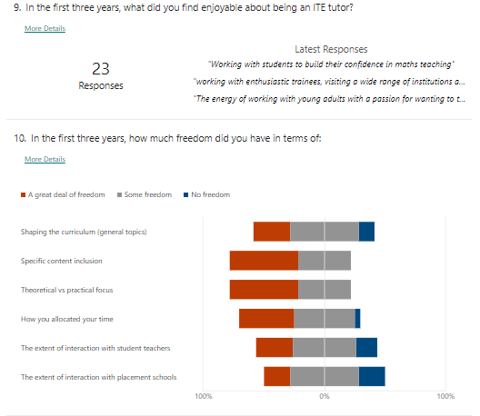
Findings – Freedom to shape the course
Lots of opportunity to shape the course to at least some extent
Substantially more freedom in secondary to allocate time, substantially less freedom in primary to shape the curriculum
Respondents who had been in post over 10 years had much more freedom at induction, but people currently being inducted have more than those in post within 10 years
Notes:
Fiona
75% of secondary said ‘great deal’ of freedom re time allocation cf 27% of primary
18% of primary said no freedom re shaping curriculum generally, (0 of secondary) and 27% said no freedom re interaction with schools (cf 13%)
Over half of the 10 yrs + had great deal of freedom, partic with content and focus, about 1/5 of 3-10 yrs said great deal and 1/5 said no freedom, but 1/3 of up to 3 yrs.

Slide 22
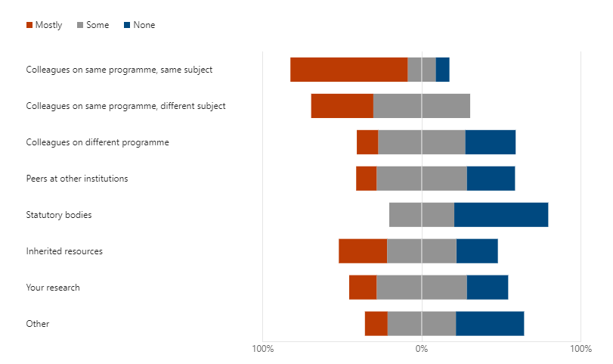
Findings – Guidance providers
Almost everyone was guided by close colleagues more than anyone/thing else
Primary were more likely than secondary to have support from colleagues on the same course, secondary were much more likely to have some support from peers at other institutions
Notes:
Fiona
Primary ‘mostly’ 82% guided by same programme same subject, cf secondary ‘mostly’ 63%. Secondary ‘some’ 88% peers in other institutions, cf primary 36% (55% none).
No substantial differences in terms of years of experience
Consistent with van Velzen et al (2010) – 5 of the 11 novice TEs interviewed had mentors, but not necessarily valued – all referred to working with colleagues in an informal or self-initiated support capacity. Different countries used courses and workshops differently, but mostly for practical/technical skills

Slide 23
Findings – Guidance areas
We asked what guidance did you find very helpful?
Responses were often about who provided the guidance, but areas included
Understanding what was happening in schools
Knowing about relevant research
Explanation of university procedures
Pedagogical tips
Collaborative planning
Availability of student support
Notes:
Fiona
Swennen et al (2009) reviewed literature and found little induction for TEs except in Israel (which often recruits from academic background not school-based). They found areas of guidance to be professional knowledge, practical solutions to day to day difficulties, research and theories of education and professional confidence, which our results fit with.
Van Velzen et al (2010) added assessment/supervision of PSTs – perhaps our participants had more experience in prior TE activity (83% had worked as ITE or ECT mentor prior to starting as TE in current role)

Slide 24
Findings – Guidance areas
We asked what guidance would you give a new ITE tutor?
Support with pedagogic/andragogic approaches
Support with where to find research to utilise in the programme
Support with academic assessment (marking assignments)
Time management
Pedagogy
General knowledge
Researcher identity
School liaison
Institution
(Murray & Male, 2005)
Navigating legislation and bureaucracy
University practice and procedures – freedom issues vs demands (protect time)
Notes:
Fiona
The challenge of marking academic and practical assignments is briefly mentioned in Boyd et al. (2021) but not a strong feature in the literature

Slide 25
Findings – advice for people new to ITE
Talk to colleagues and listen to advice, yet have confidence
Build a community with colleagues at HEI and school, to develop a sense of belonging
Prioritise PST needs over others’ demands of you
Hold true to your beliefs and values when navigating a path through requirements
Research widely: academic studies as well as tips and tricks
Experiment with pedagogy, and encourage PSTs to do the same
Keep up to date with subject knowledge and classroom practice
Take part in subject associations, conferences, CPD
Notes:
Fiona
Swennen et al. (2009) suggest working with colleagues on pedagogy and curriculum, observations and feedback with other TEs, creating support group for identity issues and undertaking research

Slide 26
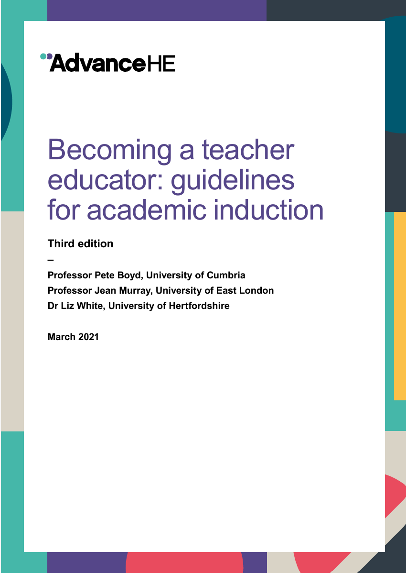
recommendations
Employers: Induction for HE setting and HE profession, analysing first-order knowledge to make explicit, provide foundation for HE pedagogy (Murray & Male, 2005). Recognise background in teaching, not same as other HE tutors
Individuals: Mission statement identifying position on role as teacher educator, organisational learning, pedagogy for ITE and scholarship/research (Boyd et al., 2021)
Awareness of Boyd et al.’s guide https://tinyurl.com/3hp5pfwz and ERASMUS website https://info-ted.eu/
Notes:
Fiona
Swennen et al. (2009) suggest working with colleagues on pedagogy and curriculum, observations and feedback with other TEs, creating support group for identity issues and undertaking research
ERASMUS website has international perspectives

Slide 27
Our Next steps
Q3
Further research into what constitutes CK, PK and PCK in an ITE context
Feedback from novices regarding their ‘buddying’ needs
Being part of a community of teacher educators
Support to become an active researcher
Create a resource about knowledges for ITE
Set up a buddy system through AMET across institutions; provide role models
Encourage AMET membership and attending webinars
Buddy system; Cross-institutional opportunities for research with AMET colleagues
Notes:
Ashley
Swennen et al. (2009) suggest working with colleagues on pedagogy and curriculum, observations and feedback with other TEs, creating support group for identity issues and undertaking research

Slide 28
Your experiences and suggestions
Q4
Do your experiences match what we have presented?
What is your reaction to our suggestions?
Have you found solutions to any of the issues?
What additional solutions would you suggest?
What barriers would there be?
https://uofsussex.padlet.org/kagladwin1/amet-considers-induction-np81xwo820d9ywcq
Notes:
Ashley
Let us know your thoughts by using the QR code to get to our padlet

Slide 29
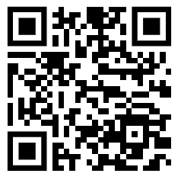
Survey
If you haven’t yet done the survey, we would welcome your input
Feel free to contact us directly:
F.r.curtis@reading.ac.uk
ashley.compton@bishopg.ac.uk
k.a.gladwin@sussex.ac.uk
https://forms.office.com/r/mxd86ywURJ
Notes:
Ashley
Let us know your thoughts by using the QR code to get to our padlet

Slide 30
REferences
Boyd, P. (2021, October 19) Being a subversive teacher educator. https://www.bera.ac.uk/blog/being-a-subversive-teacher-educator
Boyd, P., Harris, K., & Murray, J. (2011). Becoming a teacher educator: Guidelines for induction (2nd ed.) Escalate: Subject centre of the Higher Education Academy, Bristol, UK.
Boyd, P., Harris, K., & Murray, J. (2021). Becoming a teacher educator: Guidelines for academic induction (3rd ed.) AdvanceHE.
Braund, M. (2015). Teacher educators professional journeys: Pedagogical and systemic issues affecting role perceptions. Africa Education Review, 12(2), 309-330.
Cochran-Smith, M., Grudnoff, L., Orland-Barak, l. & Smith, K. (2020). Educating teacher educators: International perspectives. The New Educator, 16(1), 5-24. doi.org/10.1080/1547688X.2019.1670309.
Czerniawski, G. (2018). Teacher educators in the twenty-first century : Identity, knowledge and research. Critical Publishing.
Czerniawski, G., Guberman, A., & MacPhail, A. (2017). The professional development needs of higher education-based teacher educators: An international comparative needs anaylsis. European Journal of Teacher Education, 40(1), 127-140.
Izadinia, M. (2014) Teacher educators’ identity: A review of literature. European Journal of Teacher Education, 37(4), 426-441.
Knowles, M., Holton III, E., & Swanson, R. (2011). The adult learner: The definitive classic in adult education and human resource development (7th ed.). Butterworth-Heinemann.
Laudel, G., & Glaser, J. (2008). From apprentice to colleague: The metamorphosis of early career researchers. Higher Education, 55, 337-406.
Lunenburg, M., Denderink, J., & Korthagen, F. (2014). The professional teacher educators: Roles, behaviour and professional development of teachers. Sense Publications

Slide 31
REferences
Merriam, S., & Baumgartner, L. (2020). Learning in adulthood. Jossey-Bass.
Murray, J. (2014). Teacher educators' constructions of professionalism: A case study. Asia-Pacific Journal of Teacher Education, 42(1), 7-21.
Murray, J., & Male, T. (2005). Becoming a teacher educator: Evidence from the field. Teaching and Teacher Education, 21(2), 125-142.
Niklasson, L. (2019). Transition from teacher to teacher educator – Teacher educators’ perceptions. Journal of Advances in Education and Philosophy, 3(12), 436-444.
Pope, S., & Jones, K. (2005). Who trains the new teachers? Supporting tutors new to initial teacher education in mathematics. Paper presented at ICMI Study 15 on the Professional Education and Development of Teachers of Mathematics, Brazil.
Rieg, S. A., & Helterbran, V. R. (2005). Becoming a teacher educator. Education, 126(1), 47–47.
Simmons, M., & Back, J. (2014). The pre-service mathematics teacher as an adult learner. In R. Hyde & J. Edwards (Eds.), Mentoring mathematics teachers (pp.154-168). Routledge.
Swindon, A., Jones, K., & Volman, M. (2010). Teacher educators: Their identities, sub-identities and implications for professional development. Professional Development in Education, 36(1-2), 131-148.
Swennen, A., Shagrir, L. ,& Cooper, M. (2009). Becoming a teacher educator: Voices of beginning teacher educators. In A. Swennen & M. van der Klink (Eds.). Becoming a teacher educator: Theory and practice for teacher educators (pp. 91–102). Springer.
van Velzen, C., van der Klink, M., Swennen, A., & Yaffe, E. (2010). The induction and needs of beginning teacher educators. Professional Development in Education, 36(1-2), 61-75.

