Slide 1
UCL Centre for Climate Change and Sustainability Education
Teaching for Sustainable Futures
A Professional Development Programme for Teachers
Image credit: Hero Images / Adobe Stock

Slide 2
Teaching for Sustainable Futures is a free online professional development programme to help teachers embed issues of climate change and sustainability into their teaching practice. Currently available for history and geography (primary and secondary) and soon for English and mathematics (primary and secondary) and secondary science.
Key features include:
Free for all teachers; accessible online at any time.
Tailored to individual subjects and to primary and secondary age phases.
Research-informed; developed with teachers.
Quality assured by UCL.
Aligned with the National Curriculum in England but adaptable to any classroom setting.
Each online module takes about 90 minutes to complete. You can do it all at once or revisit whenever you have some time. They can be done individually or with colleagues.

Slide 3
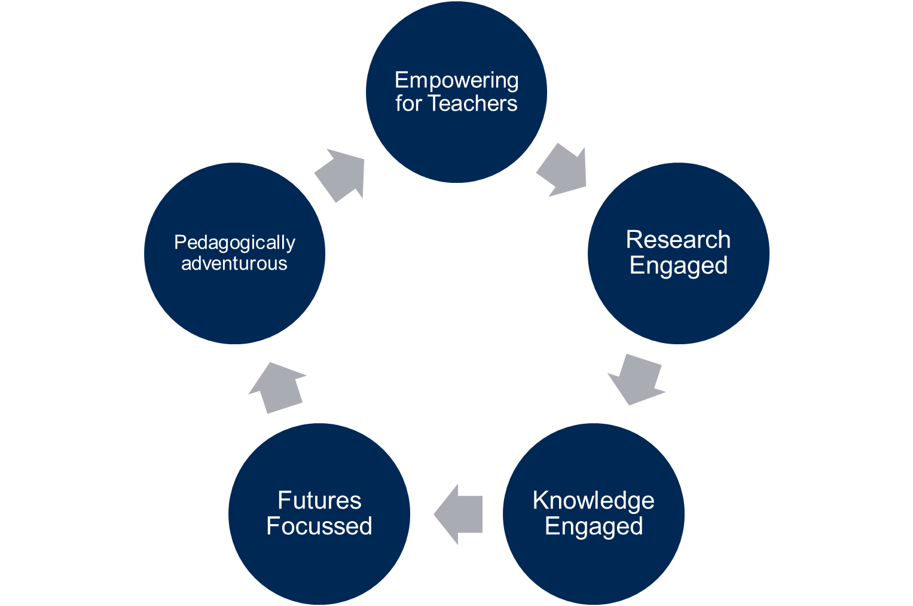
Principles
Notes:
Professional development which supports schools to implement teacher professional development that enables all young people to access effective and transformative climate change education.
Teaching for Sustainable Futures will empower teachers to draw on their age-phase and subject expertise whilst also supporting teachers to engage with climate change as a challenge which has political, economic, social, ethical complexities as well as scientific realities.
Will situate climate change in the wider context of environmental sustainability, which can be explored across the whole curriculum through an appreciation of nature, an understanding of biodiversity loss, the uneven social implications of climate change around the world, the ways that we can live more sustainably and so on.
History lessons, for example, can help young people understand how we reached this point of crisis and when the turning points in our journey towards the Anthropocene began.
In mathematics, students can explore the way climate change predictions are calculated or work out how much energy solar panels on the roof of the school are generating and how much money and carbon emissions that is saving.
Art lessons can allow students to depict a world that isn’t seen through an anthropogenic perspective and explore sustainable art practices.
And in primary schools, students can engage with local environments, explore ways to make their school sites greener, learn about sustainable practices and understand how all aspects of nature are connected.
Geography and History will be launched in July.

Slide 4
Outcomes for young people
Every child and young person has the agency and capabilities to act for the environment
Every child and young person is equipped to contribute to a socially just, equitable and compassionate world
Every child and young person experiences a life-long connection with nature which enhances their physical and mental well-being
Every child and young person understands the planet as an interconnected system and their place in human and more than human communities
Notes:
Professional development which supports schools to implement teacher professional development that enables all young people to access effective and transformative climate change education.
Teaching for Sustainable Futures will empower teachers to draw on their age-phase and subject expertise whilst also supporting teachers to engage with climate change as a challenge which has political, economic, social, ethical complexities as well as scientific realities.
Will situate climate change in the wider context of environmental sustainability, which can be explored across the whole curriculum through an appreciation of nature, an understanding of biodiversity loss, the uneven social implications of climate change around the world, the ways that we can live more sustainably and so on.
History lessons, for example, can help young people understand how we reached this point of crisis and when the turning points in our journey towards the Anthropocene began.
In mathematics, students can explore the way climate change predictions are calculated or work out how much energy solar panels on the roof of the school are generating and how much money and carbon emissions that is saving.
Art lessons can allow students to depict a world that isn’t seen through an anthropogenic perspective and explore sustainable art practices.
And in primary schools, students can engage with local environments, explore ways to make their school sites greener, learn about sustainable practices and understand how all aspects of nature are connected.
Geography and History will be launched in July.

Slide 5
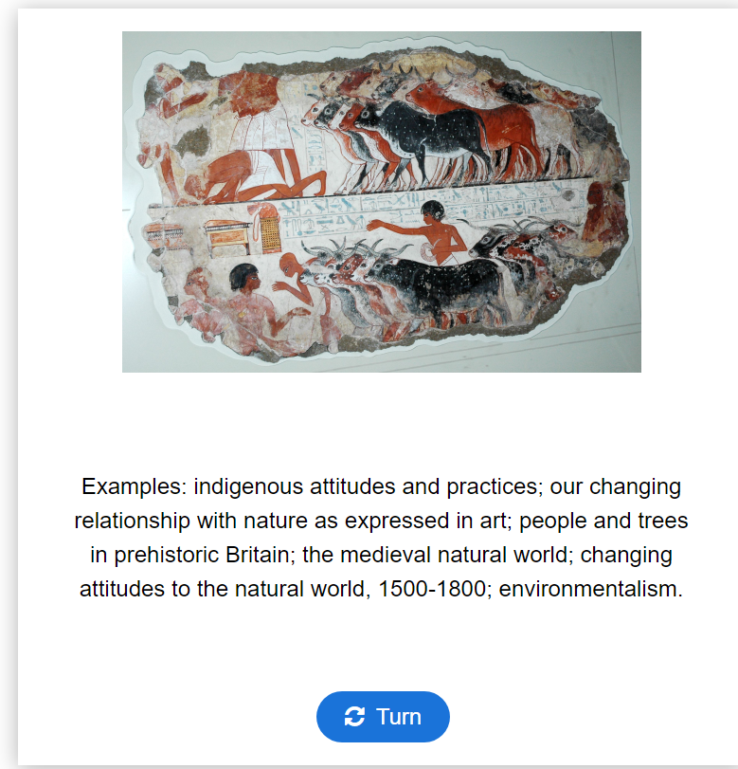
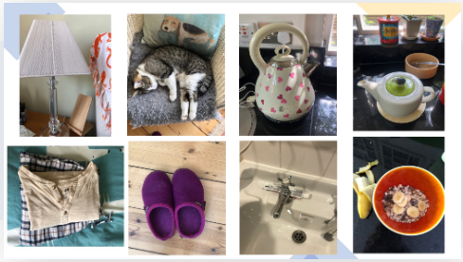
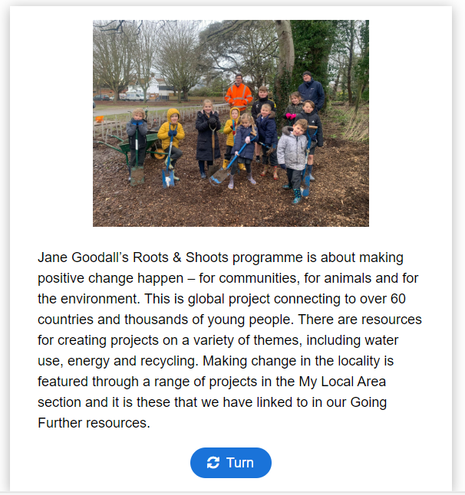
What do the modules look like?

Slide 6
Primary Mathematics
1.Consumption and sustainability; The role of mathematics to awaken our sustainability consciousness
- How can we use mathematics to ‘awaken our sustainability consciousness’ in critically examining our impact on the planet through mathematical reasoning, mathematical fluency and through problem solving. (45 mins)
2. Nature and Mathematics- The role mathematics can play in becoming intuitive and developing a deep symbiotic connection with our natural environment. (20 mins)
3. Social Justice and Mathematics- The role mathematics can play in examining inequalities and exploring climate justice and the part we can play, as a collective, to shape a new frontier of learning and thinking. (15 min)

Slide 7
Primary Mathematics module structure
1.Consumption and sustainability.
3.Social Justice and Mathematics.
2.Nature and Mathematics.

Slide 8
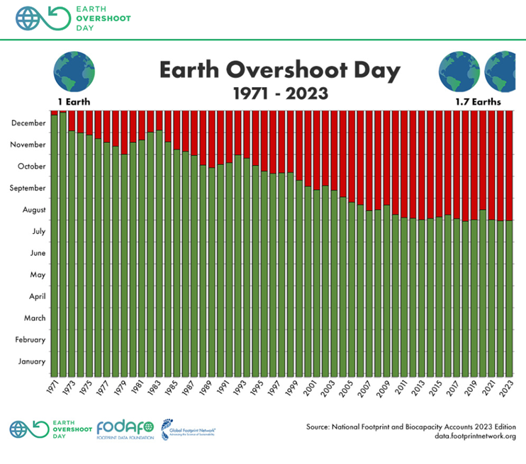
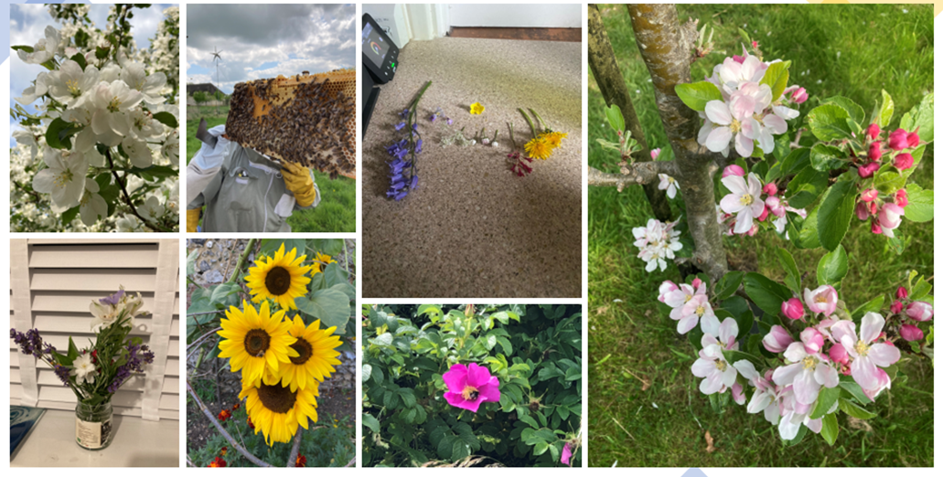
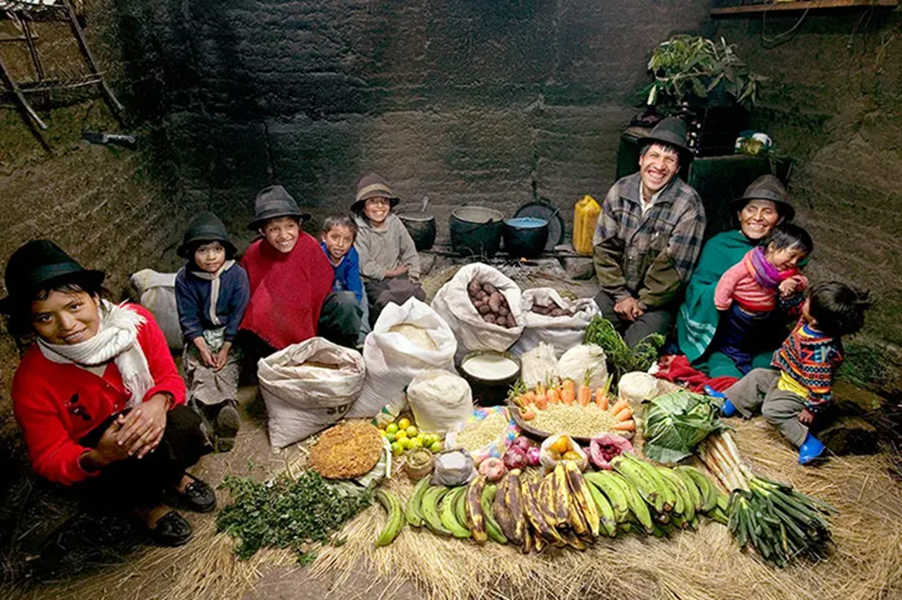
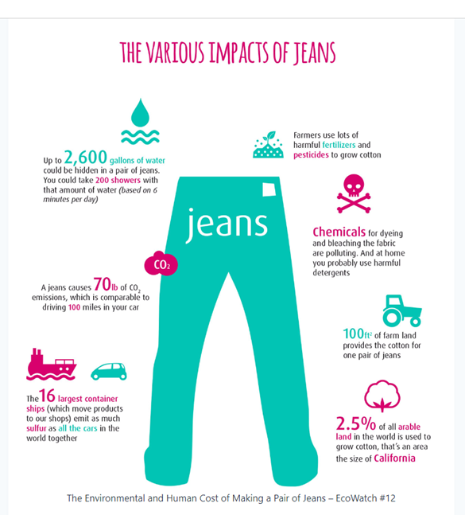
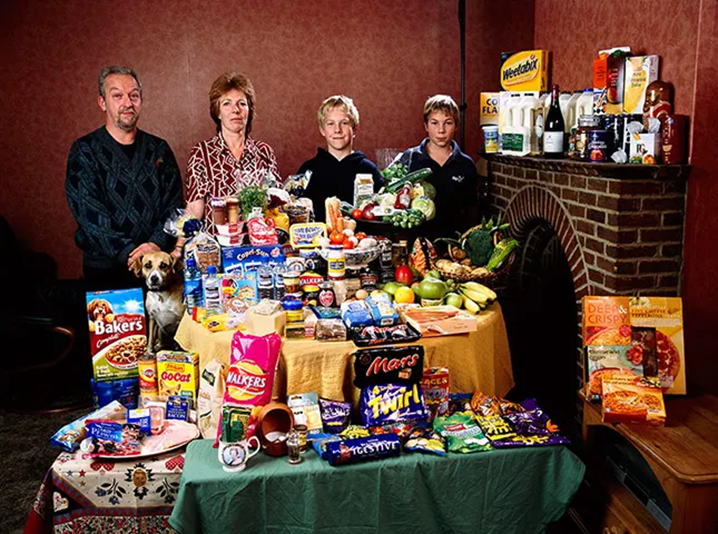
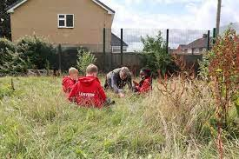
Content
2
1
3
Consumption and sustainability
Nature and Mathematics
Social justice and mathematics

Slide 9
Mapping to the aims of the mathematics National Curriculum
become fluent in the fundamentals of mathematics, including through varied and frequent practice with increasingly complex problems over time, so that pupils develop conceptual understanding and the ability to recall and apply knowledge rapidly and accurately
reason mathematically by following a line of enquiry, conjecturing relationships and generalisations, and developing an argument, justification or proof using mathematical language
can solve problems by applying their mathematics to a variety of routine and non-routine problems with increasing sophistication, including breaking down problems into a series of simpler steps and persevering in seeking solutions

Slide 10
Teaching for sustainable futures The potential of secondary mathematics
Mathematics is crucial to our understanding of climate change. Without mathematics, it would be difficult to have a global view of climate change.
Barwell (2013)
The secondary maths national curriculum states that a high-quality mathematics education provides a foundation for understanding the world.
This module aims to develop teacher’s skills and knowledge to appreciate the potential that classroom mathematics has to understand the world, more specifically, the opportunities it allows to examine issues of climate change and sustainability.

Slide 11
Teaching for sustainable futures The module
How mathematics teachers can help children have
a deeper understanding of their world.
Revealing the world through numbers with a focus on population data
Mathematical solutions to current issues of climate change and sustainability
Mathematics as a tool to critically examine issues of climate change and sustainability.
Your Environment - Exploring how maths can help at a local level

Slide 12
Section 1: Revealing the world through numbers with a focus on population data
DO
Watch the UN video below and NOTE DOWN the mathematics used in this video about population.
THINK/DISCUSS
Thinking about the maths in the video. How closely the does the maths covered in the video tie in with curriculum topics you cover in the classroom?
Here are some ideas:
1 Estimation
2 Rates of Change
3 Representing Large Numbers
4 Extrapolating Graphs

Slide 13
Section 1: Revealing the world through numbers with a focus on population data
NC:
Model situations mathematically and express the results using a range of formal mathematical representations
Ideas:
1.
In class you could explore world population and extrapolate
data to forecast the population in 2100. Pupils could draw a
graph or find an algebraic model.
2.
How could you represent your predictions?
Infographics
Graph
Table
What are the merits and limitations of each?

Slide 14
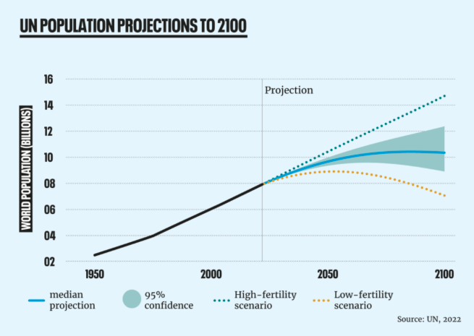
Section 1: Revealing the world through numbers with a focus on population data
Extrapolating data
How your predictions compare to the United Nations prediction
Why have the UN made a prediction which ranges from 7 billion to 15 billion?
What factors could lead to a high fertility scenario or a low fertility scenario?
Look for other divergent estimates of population data – how and why are there predictions of different trends?

Slide 15
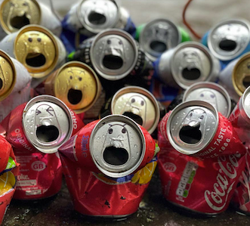
Section 2 : Mathematical Solutions
Mathematics can be a powerful tool to identify and find solutions to environmental problems.
For example, pupils could engage with food packaging and present mathematically backed solutions to minimise wastage in packaging.

Slide 16
Section 2 : Mathematical Solutions
180 Billion aluminium drinks cans are produced each year.
A drinks can holds 330ml. Cans can be different shapes.
What combination of radius and height will minimise the amount of material needed for a drinks can?

Slide 17
Section 2 : Mathematical Solutions
How closely the does the maths tie in with curriculum topics you cover in the classroom?
Here are some ideas:
Calculating the volume and surface area of a cylinder
Use a table or spreadsheet to investigate various combinations of dimensions that give the required
volume.
Using algebra to formulate mathematical relationships.
Model situations or procedures by translating them into algebraic expressions or formulae and by using graphs.

Slide 18
Section3 : Critical Mathematics
A critical maths approach can empower pupils to question information and be mathematically literate.
This is particularly important when pupils are involved in debates and discussions about climate change and sustainability.

Slide 19
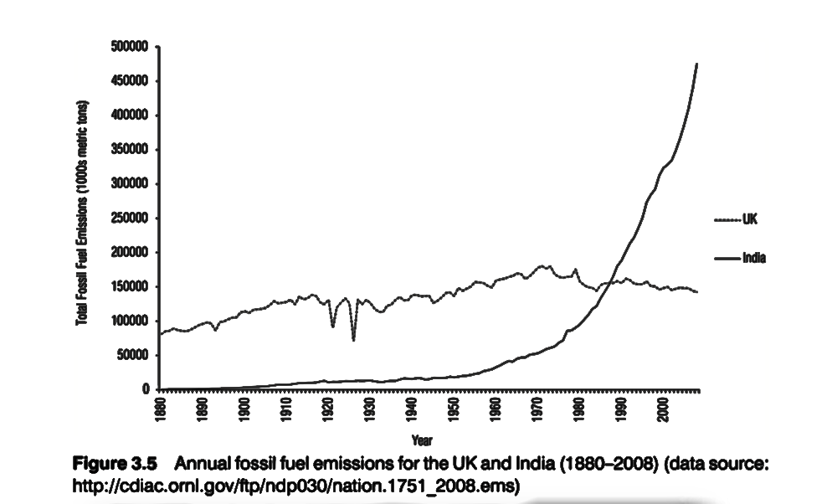
Section3 : Critical Mathematics
The following graph shows annual fossil fuel emissions in UK and India from 1880 to 2008. The data does not lie, but can it be presented to tell a different story?
Discuss alternative ways this data can be represented to tell a different story about UK and India fossil fuel emissions. How might this discussion be useful in the classroom?

Slide 20
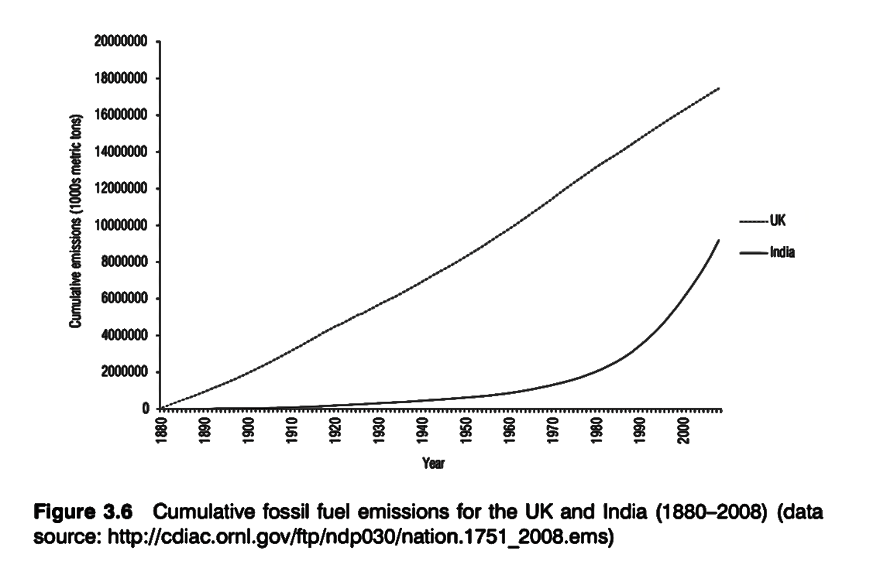
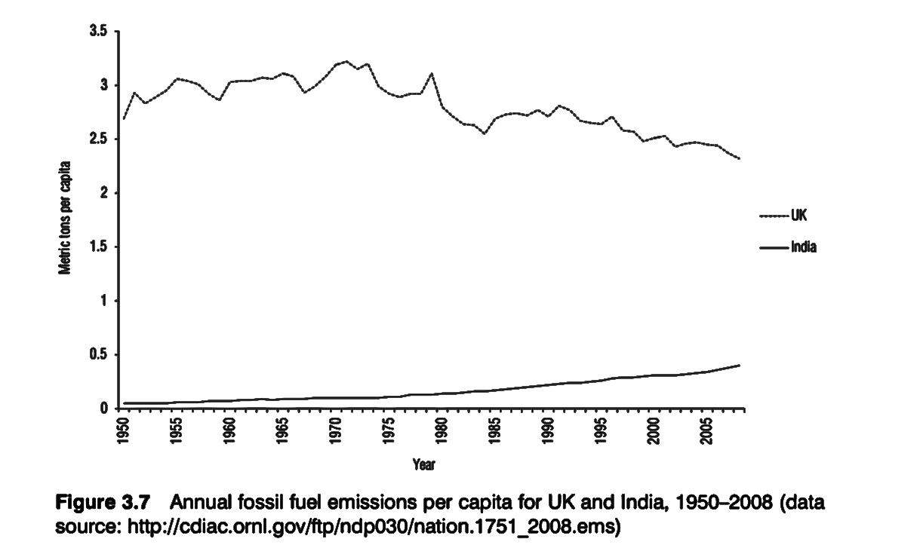
Section3 : Critical Mathematics
These different graphs are based on the same data. Which gives a ‘truer’ picture?
This graph shows cumulative fossil fuel emissions
in UK and India from 1880 to 2008.
This graph shows annual fossil fuel emissions in UK and India from 1880 to 2008 based on metric tons per capita.

Slide 21
Section3 : Critical Mathematics
These different graphs are based on the same data. Which gives a ‘truer’ picture?
Perhaps the truest picture comes from looking at all of them. Graphs are not entirely neutral.
(Barwell, 2013)
NC
Reason mathematically by following a line of enquiry, conjecturing relationships and generalisations, and developing an argument, justification or proof using mathematical language
Interpret mathematical relationships both algebraically and graphically

Slide 22
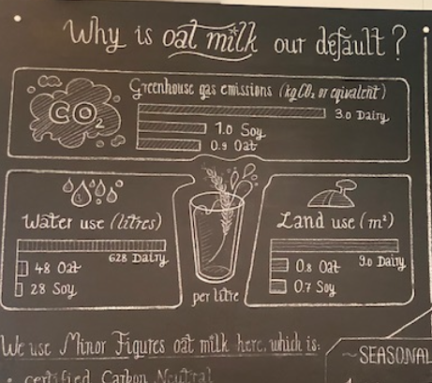
Section 4 : Your Environment
Here’s an example of how information can be
represented mathematically to encourage positive
changes for sustainability.
Can you do something similar with the menu in your school canteen?
Patrick from Comborton School is going to discuss how the mathematics department at his school addresses issues of climate change and sustainability through maths. (Create change, Energy Sparks…)
On the wall of UCL Student Café

Slide 23
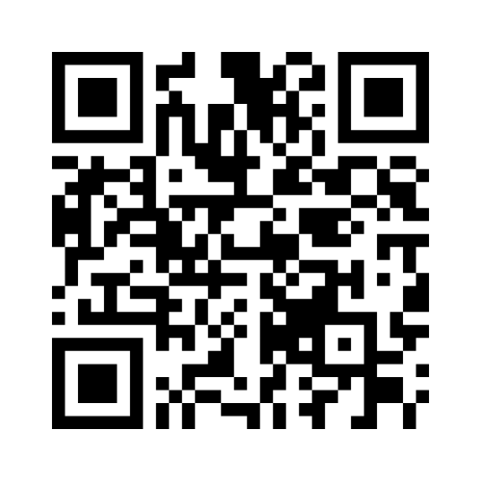
Join at Menti.com-87 32 83 5

Slide 24
Teaching for Sustainable Futures
Professional Development Programme for Teachers
Image credit: Hero Images / Adobe Stock

