Slide 1
ITaP models
Bishop Grosseteste University
BA (Hons) Primary Education with QTS

Slide 2
General model from NIoT
Marshall, L., Vidolova, D., Channa, A., Malik, S. and Mackin, A (2023). Intensive Training and Practice Pilot: Evaluation report. National Institute of Teaching. https://niot.s3.amazonaws.com/documents/Intensive_Training_and_Practice_Pilot_Evaluation_Report.pdf

Slide 3
Year 1 Subject knowledge audit
9:00 - 10:00 | 10:30-12:30 | 13:30-15:30 | 16:00-17:00
Introduce | Analyse | Prepare | Enact and Assess
Lecture - audits and developing subject knowledge | Complete audits and begin their action plans | Research to develop own knowledge of something identified in the audits then plan how to teach it to peer | Teach peers while tutors observe; peer feedback

Slide 4
Year 1 Phonics (and maths)
9:00-10:00 | 10:30-12:00 | 13:00-14:30 | 15:00-16:00
Introduce | Analyse & Prepare | Enact & Assess | Assess
Model reading a story; Explain the tasks for the two days; Provide a model for giving feedback | Students read a selection; Use subject knowledge to identify key vocabulary, literary devices, general knowledge...choose one & practise reading aloud | In groups of 4/5 students read their story aloud and video each other. Give peer feedback on strengths and areas for improvement. Identify ways to improve. Plan interactions, e.g. questions, actions, joining in sections | Tutor gives feedback Collectively identify issues for the following day
9:00-9:30 | 9:30-10:00 | 10:00-10:30 | 10:30-11:00 | 11:00-12:00 | 13:00-14:00 | 14:00-15:00
Analyse | Enact | Assess | Enact | Analyse | Assess | Assess
Observe a phonics lesson | Read your story to pupils | Peer and staff feedback; identify points to improve | Read your story to a different age group | Observe maths lesson. Identify key subject knowledge, models and representations | Groups +&-; age gp differences; create pointers for reading aloud | Tutor led discussion; quiz & discussion board
In local school |  |  |  |  | On campus

Slide 5
Year 1 - EYFS enhanced provision
9:00-10:00 | 10:00-11:00 | 10:00-14:00 | 14:00-16:00
Introduce | Analyse | Prepare | Assess
Introduce enhanced provision activity | Examples of continuous and enhanced provision | Small groups plan and prepare | Share and compare planning
9:00-12:00 | 13:00-16:00
Prepare | Enact and Assess
Setting up enhanced provision | Enhanced provision with Reception children on campus Feedback from class teachers
30 minutes
Assess
Assessed group discussion Module assessment

Slide 6
Year 2 - Resources
9:30-10:30 | 10:30-12:00 | 13:00-16:00 | 16:00-17:00
Introduce | Analyse | Prepare | Assess
Introduction to ITaP task | Analyse resources | Research and prepare resources | Evaluate resources
9:30-10:00 | 10:30-12:00 | 13:00-16:00 | 16:00-17:00
Introduce | Enact | Enact | Assess
Organisation for the day | Practice using resources with peers | Use resources with children (on campus) | Evaluate resources

Slide 7
Year 2 - Teacher & TA / SENDI (2 week placement)
1.5 hours lecture Preparation for ITaP
Monday | Tuesday | Wednesday | Thursday | Friday
Role of the TA | Wider roles of teachers | Professional Relationships | Comparison of the roles of TA & teacher | (no uni input)
Monday | Tuesday | Wednesday | Thursday | Friday
What is the impact of CoP on teaching and learning | How is the graduated approach implemented | Role of the SENCo across the school | How do pupil profiles help in facilitating pupil progress | (no uni input)
30 minutes Assessed discussion - module assessment

Slide 8
Year 2 - Planning a sequence mathematics
9:00-10:00 | 10:30-12:00 | 13:00-14:30 | 14:45-16:15 | 16:30-17:00
Introduce | Analyse | Analyse | Analyse | Analyse
Planning a sequence in maths | Analyse MNP | Analyse White Rose | Analyse another scheme (Oak?) | Common features and differences
9:00-10:00 | 10:00-12:00 | 13:00-14:30 | 15:00-16:30
Introduce | Analyse | Prepare | Analyse
Use of diagnostic and hinge point activities | Examine 2 progression docs from NCETM | Create a set of hinge point questions for given progression | Analyse a sequence for 2 age groups and compare to Assessment for Mastery docs
9:00-12:00 | 13:00-15:00 | 15:00-16:00
Enact | Enact | Assess
Co-plan a sequence of lessons | Co-plan 3 individual lessons, with representations, key questions; hinge points | Present sequences for oral feedback

Slide 9
Year 2
9:00-10:00 | 10:00-12:00 | 13:00-15:00 | 15:30-16:30
Introduce | Analyse | Analyse | Prepare
Bansho and Working Walls | Read 6 articles and watch video on Bansho and create own summary of the technique | Examine examples of working walls. Compare and contrast to Bansho. | In small groups explore the different ways you can solve the problems
9:00-12:00 | 13:00-14:00 | 14:30-15:30
Enact | Enact | Assess
In small groups plan some question sequences to use with Bansho | Use the sequences with other groups | Peer and tutor feedback Were you able to articulate a range of approaches? How did the Bansho help expose structures?

Slide 10
BUT...from September 2024
Our DfE associate has advised doing full week blocks
Separate from placement
Separate from ordinary centre-based training
Each must have a clear focus
2 weeks in Year 1 – behaviour; phonics
3 weeks in Year 2 – SENDI; questioning; modelling
1 week in Year 3 - assessment

Slide 11
AMET ITaP Webinar
Wednesday 21st March 2023
The ITaP in Mathematics ITE
Sally Bamber, & Christine Packer University of Chester
s.hughes@chester.ac.uk c.packer@chester.ac.uk

Slide 12
A central aim of intensive practice placements is the consolidation of trainees’ understanding of how research and evidence inform and shape practice. Crucial to the effectiveness of intensive placement periods will be the input of experts with deep knowledge and experience of the specifics of the curriculum dimension which is in focus.
Paragraph 42

Slide 13
[Intensive training and practice] provides an opportunity to intensify the focus on specific, pivotal areas. Intensive training and practice should also build powerfully the link between evidence-based theory and practice. This means that intensive training and practice will need to be led and supported by an appropriate range of experts.
Page 26

Slide 14
Nelson & Campbell (2017, p. 132)
“‘evidence’ constitutes a range of types and sources of knowledge and information, including professional expertise and judgement, as well as data and research. Indeed, despite the considerable debate about ‘gold standards’ of research methodologies, the most frequently used sources of ‘evidence’ are often derived from professional experiences and colleagues rather than original research studies. […] we need to consider carefully the accessibility, appeal and capacity to use a range of evidence from, in and for practice.”
Nelson, J., & Campbell, C. (2017). Evidence-informed practice in education: meanings and applications. Educational Research, 59(2), 127-135. Link.

Slide 15
Whereas the outcomes of research might play a role in professional judgement, they can only ever assist professional judgement and action but can never dictate what should be done. Educational practice consists of situations that in a sense are always new and unique.
(Biesta, 2007a)
G. Biesta (2007). Bridging the gap between educational research and educational practice: The need for critical distance. Educational Research and Evaluation, 13 (3), 295-301
Research cannot supply us with rules for action but only with hypotheses for intelligent problem solving. Research can only tell us what has worked in a particular situation, not what will work in any future situation. The role of the educational professional in this process is not to translate general rules into particular lines of action. It is rather to use research findings to make one’s problem-solving more intelligent.
(Biesta, 2007b)
Biesta, G. (2007b). Why what works, won’t work: Evidence-based practice and the democratic deficit in educational research. Education Theory, 57(1), 1–22.

Slide 16
A Model of a Collaborative Lesson Research Cycle or Teacher Research Group
Preparation
Teachers and University tutors meet to agree the focus for the Teacher Research Group. Research that informs the project is shared.
Professional learning session
ITE Participants learn about the focus for the TRG, the concepts, pedagogy, current practice and research that informs the learning. The session is interactive and models lesson activities and resources. Reading sources are shared.
Three day immersion cycle
Day 1- design and professional learning
Day 2- school context and teaching
Day 3- interrogation of the learners’ responses and implications for teaching
Planning small group teaching
Participants use the models learned in the first session to design a lesson so that they can interpret the impact of the models taught on the learners’ knowledge and understanding. They work with experts to design the lesson.
Professional learning session
Participants learn how to transfer the outcomes of their small group teaching to each class’s context. They reflect on the place of the designed lesson used in the TRG within their schools. They discuss potential barriers and opportunities for enhancing learning. They identify the significance of models used for their own professional knowledge and for their practice. Participants plan further reading and identify the significance of the outcomes of this TRG for their own practice.
The collaborative lesson research cycle is aligned with Engestrom’s Expansive Learning cycle and is influenced by
models of transformative teacher education (Darling-Hammond, Cochran-Smith & Lytle)
lesson study in mathematics (Baldry & Foster) and CLR
Teacher Research Groups and Lesson design (Swan & Burkhardt)
Small group teaching
Participants teach the lesson. In some cases, one participant observes while the other teaches. All participants focus on noticing the impact of the lesson design on the pupils’ learning. They record significant comments or photograph pupils’ work.
Review of teaching and learning
Participants review the impact of the designed lesson on the pupils’ learning. They discuss significant comments or photograph pupils’ work. They reflect on how their choices seemed to influence the learning. Participants interrogate the relationships between the teacher, learners and the mathematics.

Slide 17
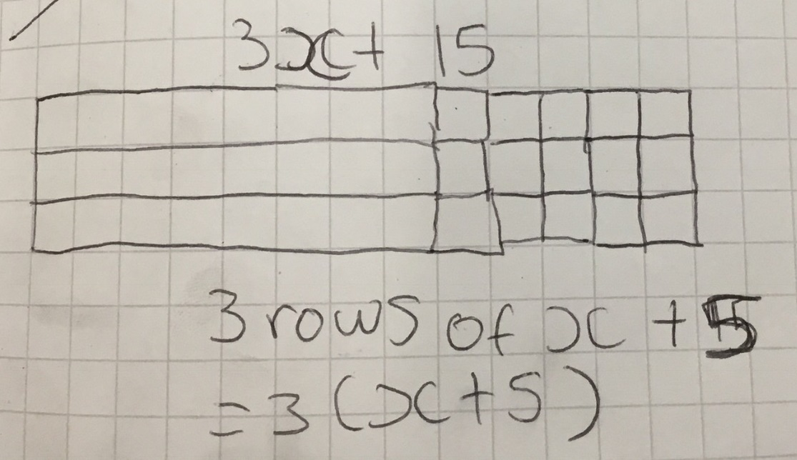
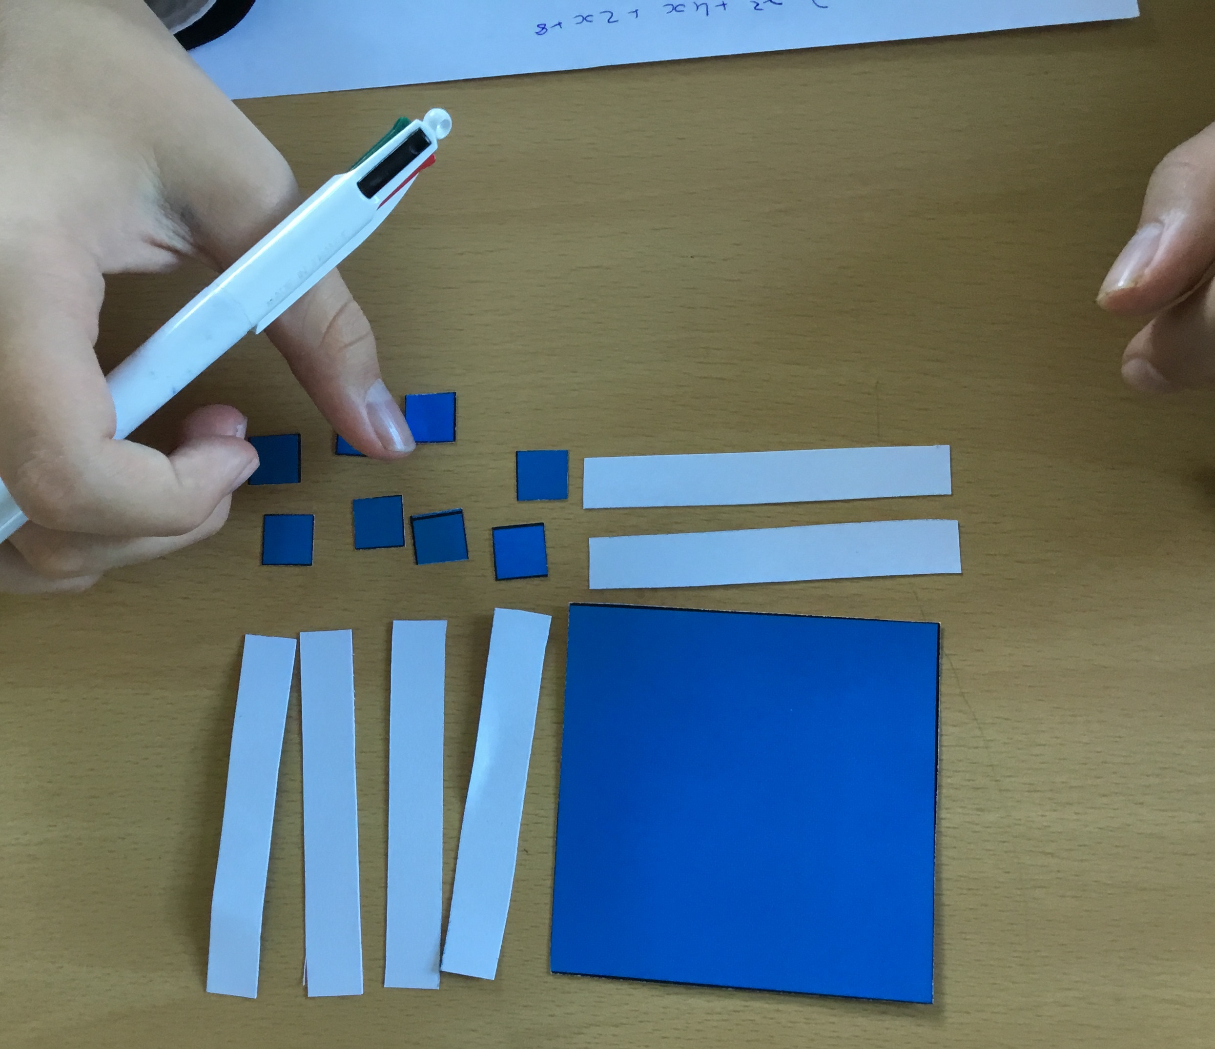
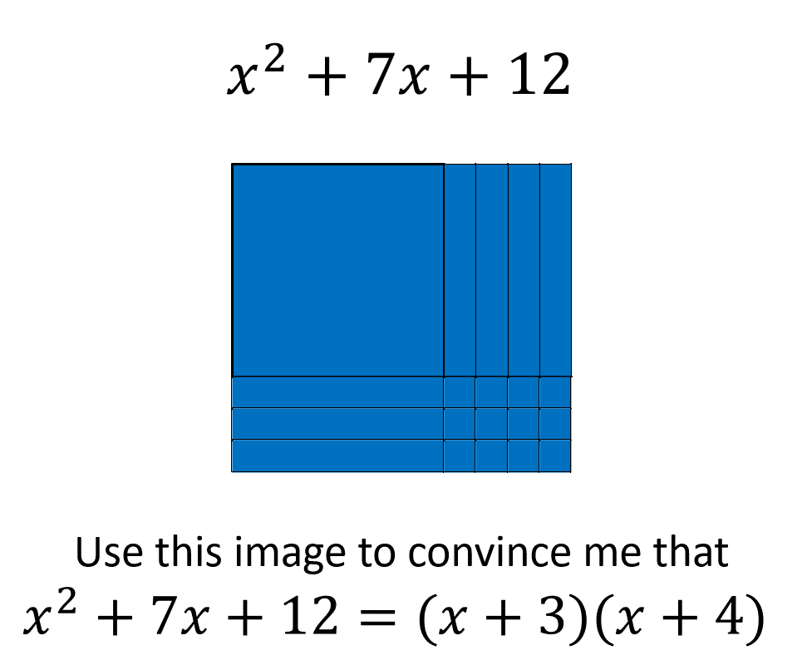
Initial Teacher Education in Mathematics
Using Research to Inform Lesson Design and Teaching in Algebra
1) Preparation
Teachers and University tutors meet to agree the focus for the Teacher Research Group. Research that informs the project is shared.
Curriculum leaders and teachers were concerned about pupils algebraic fluency, especially for middle to lower attaining pupils. The Head of Mathematics and university ITE tutors were keen to develop the use of visual and concrete representations of algebra. The ITE tutors wanted a safe environment for the ITE students to trial the use of algebra tiles before using them in the whole class context. The HoD and ITE tutor agreed the focus for a Year 10 lesson.
2) Professional learning session at University
Participants learn about the focus for the TRG, the concepts, pedagogy, current practice and research that informs the learning. The session is interactive and models lesson activities and resources.
The university ITE tutor had designed and trailed lessons in schools using algebra tiles and shared these with the ITE students. They were taught the principles behind the design of the tasks and how research that informed reasoning from known facts and making connections between multiple representations expressions. They were given insight into research that informs difficulties associated with learning algebra in secondary school. Teachers were immersed in model tasks and interrogated how these tasks might be used in their school context. Teachers explored the use an enactive representation of a variable to model a reasoned, connected understanding the structure of linear and quadratic expressions. Initially teachers focussed on equivalent expressions, with a view to applying visual and concrete representations to many aspects of equations, expressions, sequences and functions eventually.
6) Further Professional Learning
Participants learn how to transfer the outcomes of their small group teaching to the context of the placement school. They reflect on the place of the learning models used in the TRG within their classes that they share with mentors and class teachers. They discuss potential barriers and opportunities for enhancing learning. They identify the significance of these models for their own professional knowledge and for their practice. Participants are given further reading.
ITE students connect the principles from the project with their ongoing teacher education. In particular the principles of:
-Connecting with learners’ prior knowledge. -Making connections between representations. -Support-challenge as a model for differentiation.
They were encouraged to apply the TRG outcomes to their school-based learning placements.
3) Planning small group teaching: Lesson design
ITE Participants use the models learned in the first session to design a lesson so that they can interpret the impact on the learners’ knowledge and understanding. They work with experts from school/university to design the lesson.
ITE students are encouraged to designed a lesson with the aim of making equivalent expressions accessible. They are taught a support-challenge model of differentiation aligned with the principles of teaching for mastery. Support was derived from the use of the tiles. Challenge was designed through rich questions that deepened the current learning (not accelerate onto new content) and allowed pupils to interrogate the structure of expressions. ITE students use the narrative of the lesson that they had experienced to them to adapt their own lesson design.
5) Review of teaching and learning
Participants review the impact of the designed lesson on the pupils’ learning. They discuss significant comments or photograph pupils’ work. They reflect on how their choices seemed to influence the learning. Participants interrogate the relationships between the teacher, learners and the mathematics.
Initially, ITE students reflected on behaviour and engagement in the lesson. Discussions then focussed on their responses to difficulties and managing unforeseen questions/difficulties. ITE tutors discussed when they would introduce negative terms and the value of reversing the direction of the tile. Teachers shared how they had used simulations of the tiles using mathsbot.com. and were able to share the context for learning for some of the Year 10 pupils that the ITE students had noticed a specific responses to the learning. Examples of positive outcomes for pupils who do not always engage in lessons were shared. ITE students discussed potential resistance to using the tiles for higher attainers.
4) Small Group Teaching
Participants teach the lesson. In some cases, one ITE participant observes while the other teaches. All participants focus on noticing the impact of the lesson design on the pupils’ learning. They record significant comments or photograph pupils’ work.
ITE students taught the lessons to all pupils in Year 10. They recorded how pupils translated the concrete model into pictures on paper as well as recording the pupils’ emotional response to changing the context for learning algebra. Key features of the lesson were noted during the lesson or as soon as the lesson ended. The university ITE tutor and experienced teachers were on hand to support the teachers in dealing with difficulties at the point that they were exposed.
Contact: Dr Sally Bamber, University of Chester s.hughes@chester.ac.uk @DrSallyBamber

Slide 18
 | Monday | Tuesday | Wednesday | Thursday | Friday
Before break | UOC Based Theory and research that informs the focus on the ITAP. UOC led with integration of school experts’ input- context of the school and insight into the focus. | Expert in school introduces lesson design | Teach small group lesson | Observe expert in another KS | Team teach lesson
After break |  | Observe expert teachers | ATs evaluate | Analysis with experts | Analysis
After Lunch |  | Analysis of lesson through lenses from day 1. Design small group lesson for next day | Evaluate and analyse with experts Introduce to lesson for next Key Stage | Design team teaching lesson | Explicit links between theory and practice. Planning for integration into SBL.

Slide 19
Much educational research is about analysing and explaining an existing state of affairs. Design research is different. It is transformational in that it challenges the status quo, through the design and implementation of novel experiences and materials. It is also impact focused in that it goes on to study how designs function and mutate in the hands of teachers with contrasting styles, beliefs and commitment.
Malcolm Swan, 2010

Slide 20
Characteristics of Design Research
“The first characteristic is that its purpose is to develop theories about learning and the means that are designed to support that learning. The second characteristic of design research is its interventionist nature. The third characteristic is that design research has prospective and reflective components that need not be separated by a trial or so-called teaching experiment. The fourth characteristic is the cyclic nature of design research: Invention and revision form an iterative process. The fifth characteristic of design research is that the theory under development has to do real work.”
Design research takes three phases:
Preparation and Design
Teaching Experiment
Retrospective Analysis
Bakker, 2018

Slide 21
Beginning teachers experience collaborative enquiry, expansive learning, researcher and research user.
Preparation
Teachers and University tutors meet to agree the focus for the Teacher Research Group. Research that informs the project is shared.
Professional learning session
ITE Participants learn about the focus for the TRG, the concepts, pedagogy, current practice and research that informs the learning. The session is interactive and models lesson activities and resources. Reading sources are shared.
Teachers experience collaborative enquiry, expansive learning, researcher and research user, strengthened partnerships & further lesson design.
Planning small group teaching
Participants use the models learned in the first session to design a lesson so that they can interpret the impact of the models taught on the learners’ knowledge and understanding. They work with experts to design the lesson.
Professional learning session
Participants learn how to transfer the outcomes of their small group teaching to each class’s context. They reflect on the place of the designed lesson used in the TRG within their schools. They discuss potential barriers and opportunities for enhancing learning. They identify the significance of models used for their own professional knowledge and for their practice. Participants plan further reading and identify the significance of the outcomes of this TRG for their own practice.
Teacher educators experience collaborative enquiry, expansive learning, researcher and research user, strengthened partnerships & authentic PL materials inform programmes.
Small group teaching
Participants teach the lesson. In some cases, one participant observes while the other teaches. All participants focus on noticing the impact of the lesson design on the pupils’ learning. They record significant comments or photograph pupils’ work.
Review of teaching and learning
Participants review the impact of the designed lesson on the pupils’ learning. They discuss significant comments or photograph pupils’ work. They reflect on how their choices seemed to influence the learning. Participants interrogate the relationships between the teacher, learners and the mathematics.
Teacher educator as [design] researcher collaborative research and publications, researcher identity.
Access and Participation Plan?

Slide 22
Breakout room discussions
Where are you at with ITaP planning?
What approaches are you taking?
In school? On campus with pupils? On campus with peers?
How does this fit with your teaching and existing placements?
Have you had any official feedback regarding ITaPs and Stage 2?
Choose a spokesperson to feedback.

