Slide 1
Anti-racist and decolonial practice in teacher education
Over the last 25 years, I have taught children and students teachers ‘Historical and cross-cultural roots of mathematics’ with contributions such as Chinese Tangrams, Vedic (ancient Indian mathematics), Multiplication tables in different languages and Symmetry and African patterns in art / crafts / textiles. Student teachers work in groups to plan lesson activities, for example, ‘The Game AYO’, ‘Yoruba Number System’, ‘Towers of Hanoi’, ‘Crop Circles’ and ‘Tangrams, Sudoku and Kenken’. The purpose of engaging with such activities includes teaching pupils that mathematics has contributions from all over the world, over many centuries.
Manjinder K. Jagdev
York St. John University

Slide 2
The primary undergraduate students were asked: How has the conference helped to develop your understanding of inclusion & diversity?
i am going to make sure i use lots of the resources Manjinder showed us as there were so many and i have noticed when doing my research for my wider curriculum essay many subjects, especially history and science seem to be very white male dominated.
A lot of strategies and information regarding children from different ethnic minorities.
Massively - given a lot of perspective and really loved the key speakers their experiences really helped
The lectures were very informative and I have come away with a lot of strategies that I would implement in my teaching.
It has given me a deeper understanding of each group of people/children and this has enabled me to think of ways to support them more effectively
The conference was extremely informative and left me wanting to do lots more research as I feel I have only scratched the surface of what there is to learn about the different groups! I have learnt lots today and thoroughly enjoyed the day - it was filled with eye opening information which has helped inform my future practice.
It has given me a really good insight into the backgrounds children may have and how best to respond to this. It’s broadened my knowledge on things I didn’t previously have a lot of knowledge on and ways in which I can improve my teaching and outlooks.
Notes:
work is being enthusiastically received and done in predominantly white areas

Slide 3
Postgraduate secondary student feedback:
have realised the importance for the need on a push on the change of the literary canon taught in schools and the curriculum!
The links between colonialism and climate change are very interesting. Honestly, would have never made those connections before today
very useful and formative session, we are always aware of these topics but we need to push this and educate our students so they can carry it on in their journeys
As a History trainee this is making me begin to feel quite ignorant in the face of diversity in my teaching. It's definitely going to make me be mindful of this going forward
referring to previous: In Music, we did a lesson on the slave trade to give context and an introduction to the origin of blues. I try to say "enslaved people/persons" rather than "slaves". thinking about the language i use. Advice on this told me that slave isn't an identity, rather a circumstance
Were currently unpacking representation and why it's important in literature and the media. I used Marcus Rashford for this as he's very relatable and many of the boys s in the class are football mad.
we are currently discussing Marcus and Malala on our 'Inspirational people' module in English
am teaching of mice and men though soon (which is unfortunately a v racist and sexist text) so I will be trying to build in some discussion time and reflection time for students as well as addressing the issues
This is showing me that I'm definitely not doing enough! I don't think diversity is really addressed in my lesson plans at all
Thank you Manjinder, loads to think about and packed full with excellent resources.

Slide 4
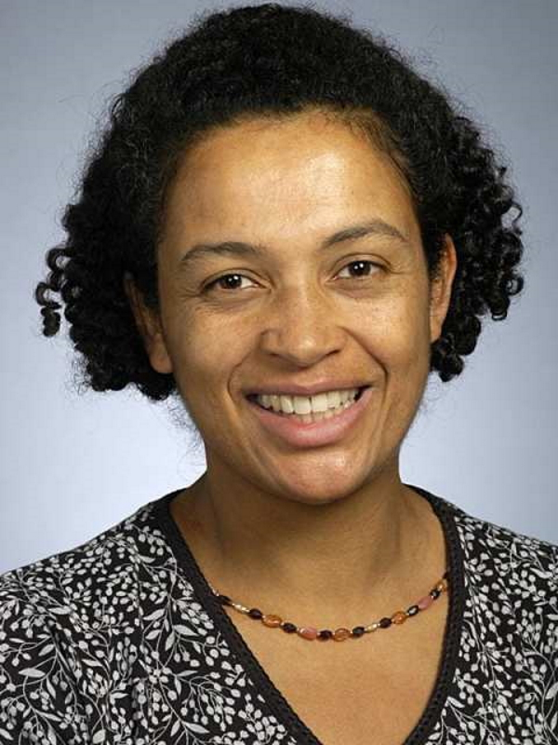
Diversity and STEM
In February 2020 Teach First launched their STEMinisim campaign to address gender gaps within STEM careers as ‘49% of British adults were unable to name a female scientist that was dead or alive’ (Teach First, n.d.).
The charity also revealed that the National Curriculum for GCSE Science does not feature the name of any woman. In addition, a review of ‘three double science GCSE specifications from the major exam boards’ highlights this comparison – two women are mentioned (Rosalind Franklin and Mary Leakey), whereas over 40 male scientists were named or had concepts and materials named after them.
Kate Okikiolu is a renowned British research mathematician who has won many prestigious awards. After completing an undergraduate degree in mathematics at Cambridge, she went on to study a PhD at the University of California at Los Angeles.

Slide 5
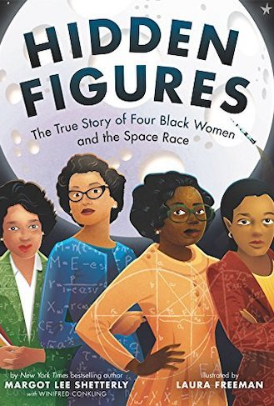
Females in maths and science
Toni Schmader from the University of British Columbia states:
‘Stereotypes reflect what people see in everyday life and can play an important role in constraining children’s beliefs of what they can/cannot do’. They might influence whether female students see a place for themselves in science, and whether they look to scientific careers at all (Yong, 2018).
Diversity can be generally taken to mean ‘the inclusion of people of different races, cultures, etc’ (Merriam-Webster, 2009).

Slide 6
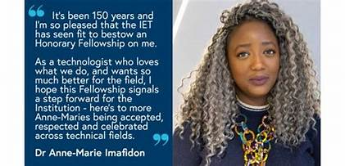
Consider…
https://www.youtube.com/watch?v=7JheC-_8I5A&t=1s
Diverse representation within text/videos/website links shared
Diverse role models as part of STEM initiatives in your school.
Scientific contributions from underrepresented groups highlighted all year round (as opposed to only during Black History Month):
https://royalsociety.org/blog/2021/10/grains-of-truth/
It is essential that the aim is to create a ‘curriculum that embraces, celebrates, highlights and foregrounds diversity’
(The Headteacher, n.d.)
Hundreds of schools in England sign up for anti-racist curriculum | Race in education | The Guardian

Slide 7
Patterns, sequences and structures in the world around us…
…in nature, in architecture and examples of patterns in the work of different artists, in textiles and cultural designs and for example, the golden ratio https://www.mathsisfun.com/numbers/golden-ratio.html

Slide 8
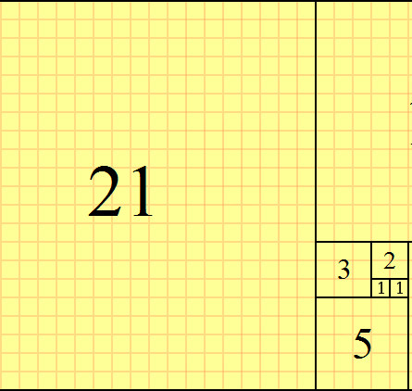
Patterns in nature
Fibonacci sequence: A tiling with squares whose side lengths are successive Fibonacci numbers: 1, 1, 2, 3, 5, 8, 13 and 21.
Fibonacci numbers are named after the Italian mathematician Leonardo of Pisa, later known as Fibonacci.

Slide 9
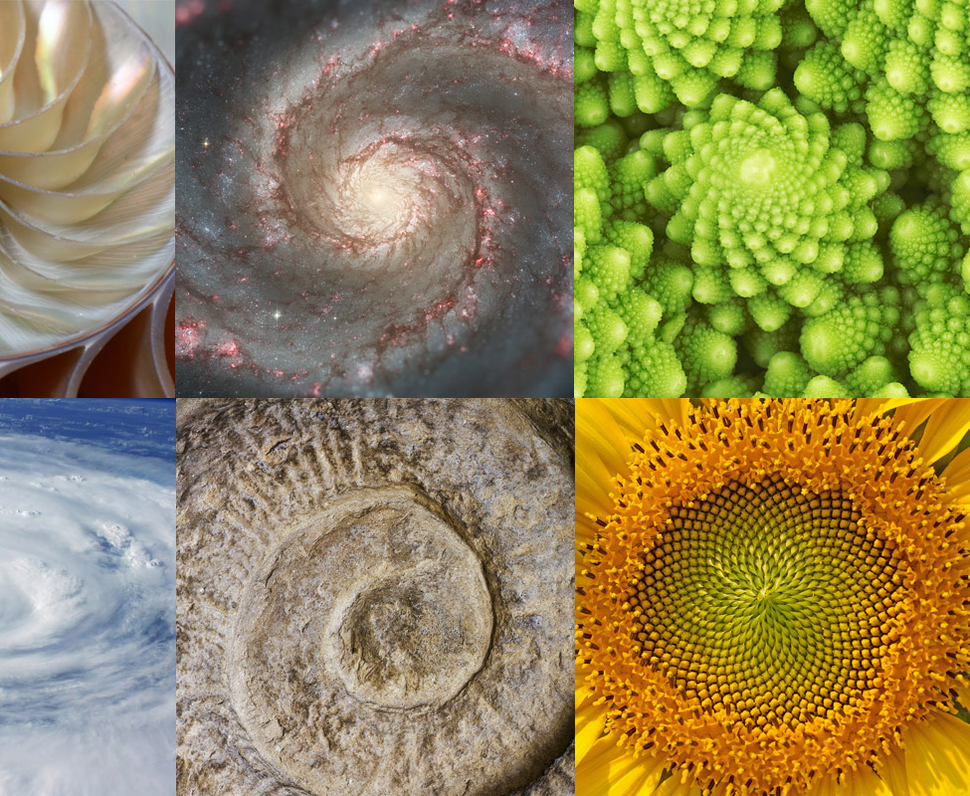
In his 1202 book Liber Abaci, Fibonacci introduced the sequence to Western European mathematics, although the sequence had been described earlier in Indian mathematics as early as 200 BC in work by Pingala on enumerating possible patterns of Sanskrit poetry formed from syllables of two lengths.

Slide 10
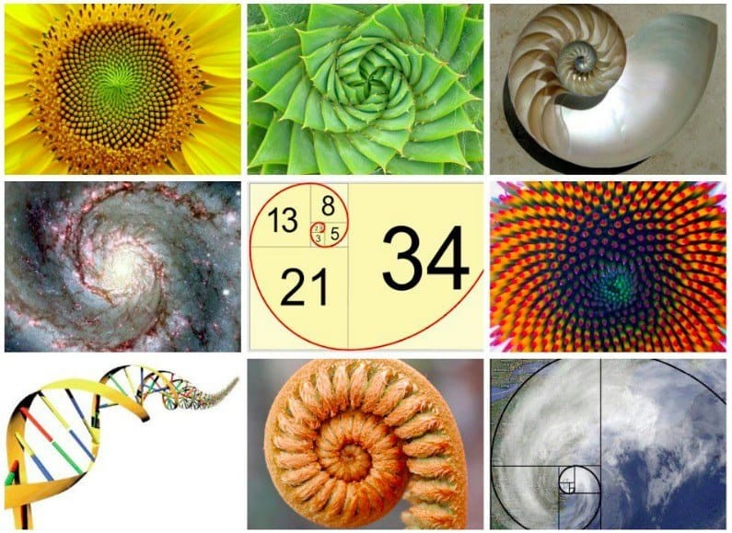
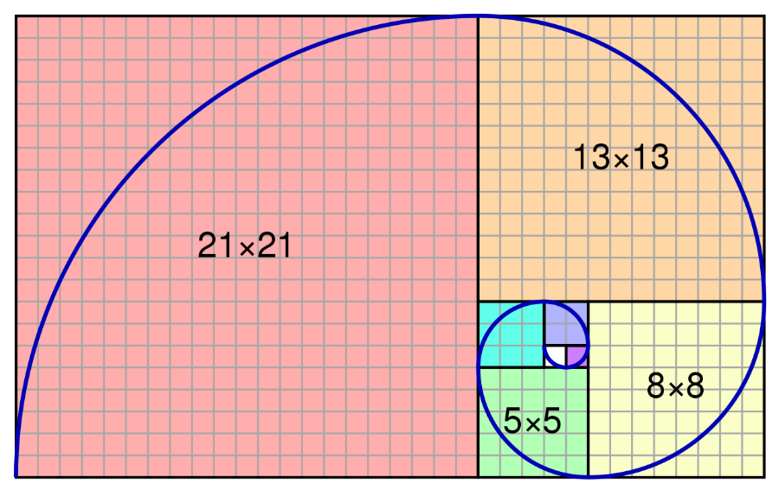
The Fibonacci spiral
This is an approximation of the golden spiral created by drawing circular arcs connecting the opposite corners of squares in the Fibonacci tiling.

Slide 11
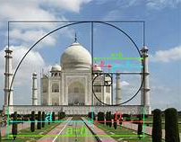
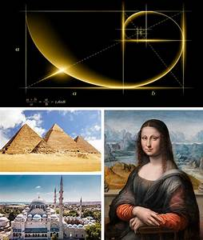
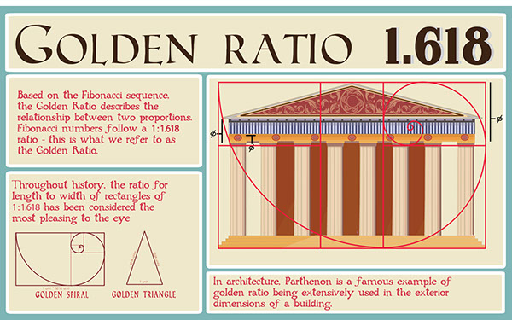
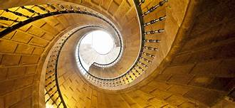
Golden Ratio – a proportioning system that governs the relationship of the smaller parts to the whole. It produces aesthetically pleasing shapes in nature, art and architecture.

Slide 12
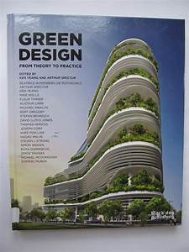
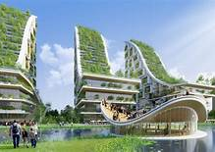
Patterns in architecture

Slide 13
The Great Mosque of Djenne in conjunction with Djenne-Djenno (literally ancient Djenne) is one of the oldest continuously inhabited sites in all of sub-Saharan Africa.
Closely linked with the history of Timbuktu, the Great Mosque is thought to be the largest standing mud architecture structure in the world and one of the best examples of Malian architecture.

Slide 14
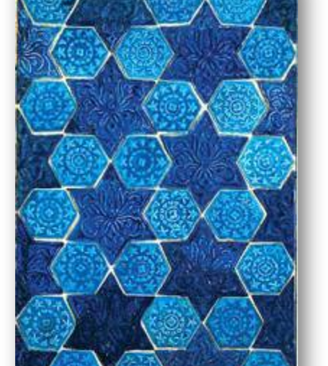
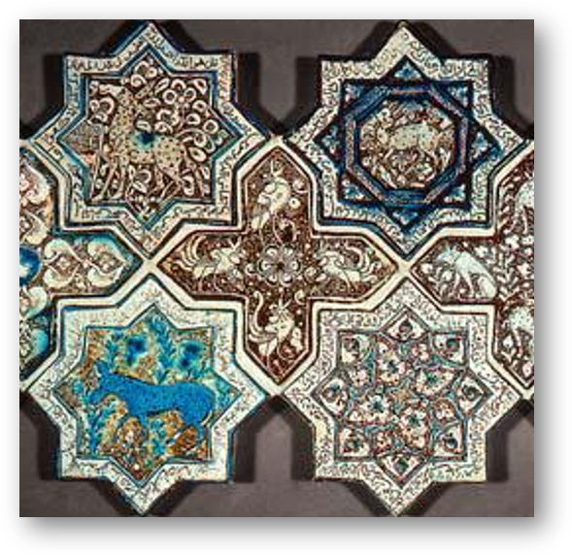
Patterns in art – links to symmetry
Make cross-curricular links with art and mathematics for example, by getting pupils to explore moulded tile patterns from 13th and 14th Century Iran, the Alhambra in Spain and interactive tessellations. Children can learn about different polygons and mathematical vocabulary and make their favourite patterns:
^{https://nrich.maths.org/6069}

Slide 15
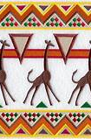
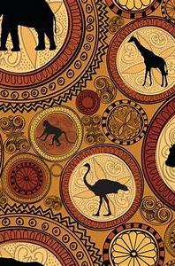
Patterns in African textiles

Slide 16
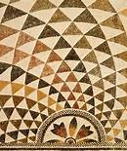
Patterns in Native American designs

Slide 17
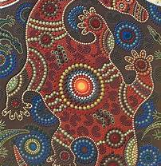
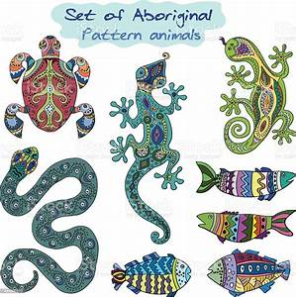
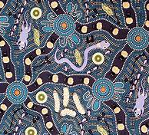
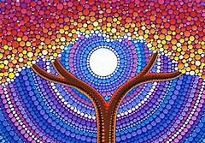
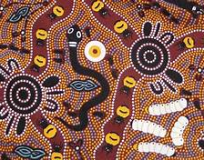
Patterns in Aboriginal designs

Slide 18
DATES
Ethiopia 2000 BC…
Ancient Nubia 2450 BC …
Malian Empire
1235 - 1400s AD
Stone Age 2.6m years ago - 3,300 BC
Bronze Age 3000 - 1200 BC
Indus Valley
2500 - 1700 BC
Benin Empire
1200 - 1400s AD
Mayan Civilisation 1800 BC - 250AD
Baghdad 900 AD
Vedics 1500 - 500 BC
Roman Empire 27BC - 476 AD
Ancient Greeks 510BC - 323 BC
Romans in Britain attempt 55BC, succeed 43AD- 410AD
Vikings in Britain 800AD-
1150AD
3000 BC
2000 BC
1000 BC
AD
1000 AD
1500 AD
2000 AD
Pre 4,000 BC
Notes:
https://www.youtube.com/watch?v=HDvQjWmV9mc
Cinco de Mayo video

Slide 19
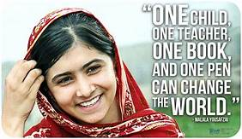
Reflection…pause for thought…
Is the diversity of your students reflected in your lesson plans?
Is the language in your learning materials non-racist/sexist/discriminatory?
Do you review your resources/lesson plans regularly?
Are negative attitudes actively challenged?
Do you promote multiculturalism in lessons?
Do your resources use multicultural themes?
Do you actively avoid using stereotypes in classroom resources and examples?
Do you actively reference and use examples from different traditions, cultures and religions?
Are you doing your best to challenge society’s stereotypes?
Adapted from (Deer, 2020)
Notes:
Show video: Cinqo de Mayo:

Slide 20
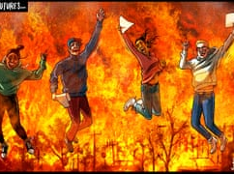
Linking racial and climate justice
Why do we need to decolonise and decarbonise simultaneously?
Colonialism, imperialism and the climate crisis:
Colonists created land boundaries - consider effects on nomadic people
South Africa and apartheid; extraction of minerals – children mining for components in electronic devices – mobile phones, ipads, laptops etc.; modern slavery (cobalt article) - https://www.theguardian.com/global-development/2021/nov/08/cobalt-drc-miners-toil-for-30p-an-hour-to-fuel-electric-cars
Notes:
What does this picture show?

Slide 21
Critical mathematics education…
Plastics pollutions and plogging groups around the world: https://www.goplogging.org/; https://gogreengo.org/plogging-crosses-the-pond-and-picks-up-in-us/
Links to racial justice and learning from indigenous peoples such as tribes, Amerindians and Aboriginal communities
People from poorer nations affected more by implications of global warming than those others, even through they contribute least to the problem.
GCSE Natural History – Mary Colwell: https://www.ocr.org.uk/news/moving-forward-with-our-gcse-natural-history-proposal/
Air pollution; deforestation; farming and agriculture; food and water insecurity; food waste; global warming from fossil fuels; housing; loss of biodiversity; plastics pollution, littering and recycling; transport; modelling COVID.

Slide 22
Further resources to use with pupils
Nature as inspiration: issue_30_primary_magazine.pdf (ncetm.org.uk)
National Geographic KIDS: https://www.natgeokids.com/uk/teacher-category/maths/
BBC Bitesize: https://www.bbc.co.uk/bitesize/articles/zdsqdp3
Quiz:https://www.bbc.co.uk/bitesize/topics/zp22pv4/articles/z2md82p?xtor=CS8-1000-[Discovery_Cards]-[Multi_Site]-[SL07]-[PS_BITESIZE~N~~A_QuizHowDoWeAffectTheEnvironment]
https://www.bbc.co.uk/bitesize/topics/zp22pv4/articles/ztxwqty
National Curriculum – Data Handling and statistics – websites: https://www.worldometers.info/

Slide 23
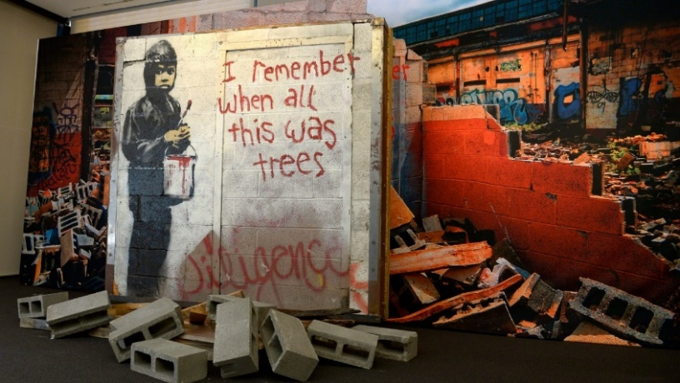
Themes
Climate emergency
Industrial relations
Curriculum
Energy and carbon management
Ethical investment and banking
Food and land-use
1. Who will you engage?
2. How will you ensure a holistic lens of both decarbonising and decolonising?
3. What is your long term vision?
4. What are the short term realistic goals?
Notes:
Banksy in California – child painting – buildings replace trees

Slide 24
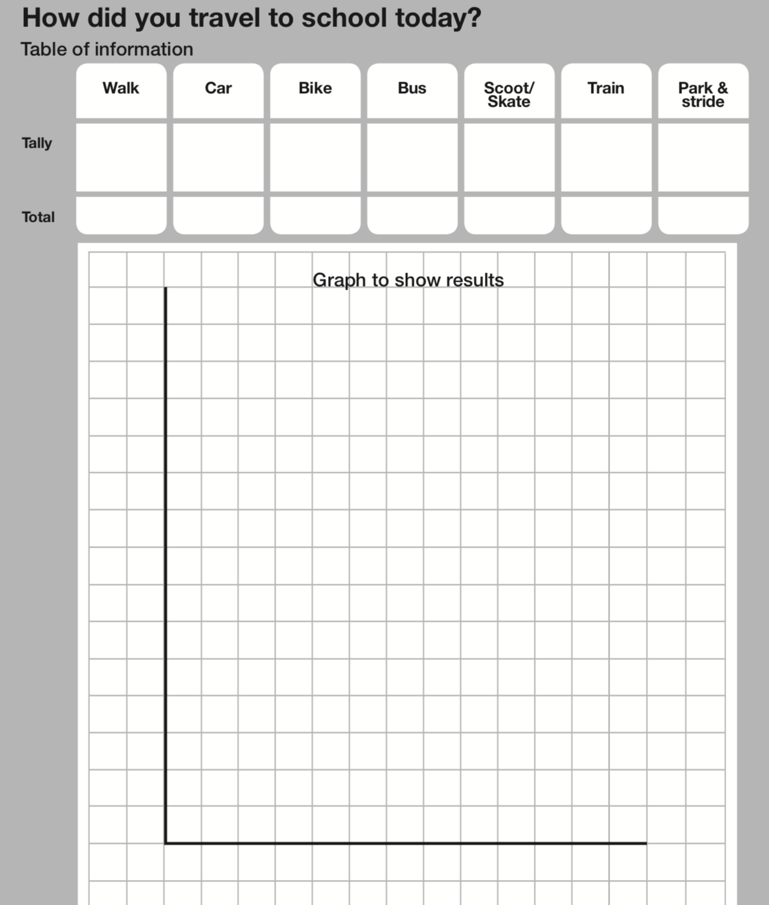
Activity for Years 3/4 Solve problems and analyse data relating to sustainable transport?
Can you create a tally of the different transport used by the group this week?
How could you now represent that data?

Slide 25
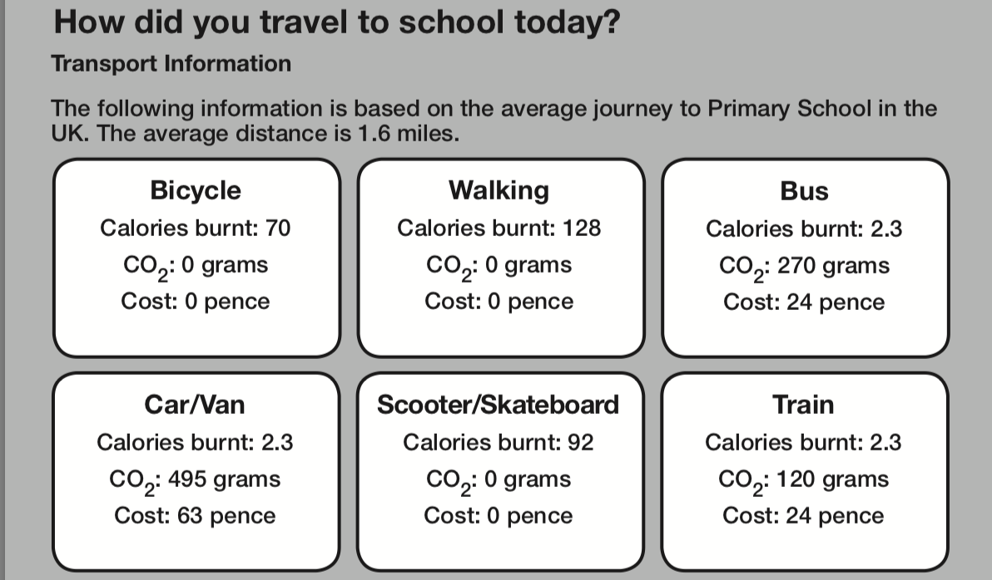
Activity for Years 5/6 Solve problems and analyse data relating to sustainable transport
Can you work out the total cost of the groups' travel if 13 people travelled by car?
How much would you save if 5 members of the group travelled by bicycle?

Slide 26
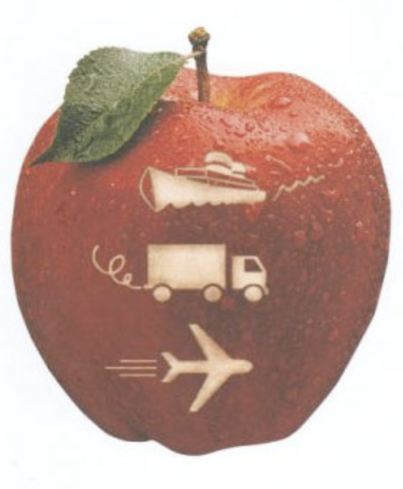
Student Activity on maths and sustainabilty: Addition and Subtraction of Food Miles
Can everyone go and grab two pieces of fruit from their kitchen?
Using the link below:
Work out the how far each piece of fruit has travelled.
Add these two amounts together to get a total distance travelled.
https://www.foodmiles.com
What is the environmental impact of this?

Slide 27
Environmental Topics that can be linked to subjects across the curriculum
Deserts
Polar regions
Mountains
Pollution
Temperature
Climate change
Cities
World population
Carbon footprint
Food miles
Rivers
Deforestation

Slide 28
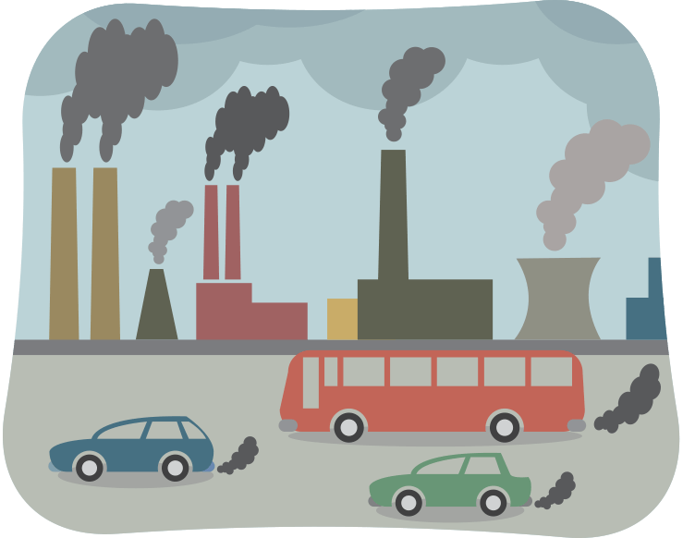
Living Lab Project and critical maths education
We can use ethical examples in teaching of mathematics by using real world examples – Covid, Global warming, Pollution of the environment, Health and mortality figures from around the world, statistics on gender and race inequalities to show the impact of models, measures and mathematisation. (Ernest, 2021)

Slide 29
Shape in shape – tutor example
Finding shapes in nature - KS1 - BBC Bitesize - The Regenerators - BBC Bitesize
Key stage 1 - Watch the 3 minutes video; explore the 2D and 3D shapes in nature
Investigate the shapes in leaves and try out the quiz with children; make the ‘sticky shapes’ as part of Forest school activities and see the Flashcard photographs
Spheres in nature

Slide 30
Where can you find symmetry in nature?
Change Champs: Where can I see symmetry in nature? - The Regenerators - Videos for teachers - Classroom resources - BBC Bitesize - BBC Bitesize
Symmetry in nature - BBC Bitesize
Key stage 2 - Watch the 3 minutes video; look at the examples of reflective and rotational symmetry in leaves and animals; try the quiz; do some leaf pressing symmetry and see the symmetry sheets to share with your children

Slide 31
Key stage 1 maths resources
What living things can I find near me? - KS1 - BBC Bitesize - The Regenerators - BBC Bitesize
Watch the four minutes video; learn to ‘Keep Track’ using the Tally charts, with examples of sorting, counting, Garden bird Watch, composition of numbers (number bonds)
Use the ‘Scavenger Hunt Nature Walk’ sheets with your children

Slide 32
Key stage 2 maths resource
Worldometer - real time world statistics (worldometers.info)
How could you use the above in class to explore world population, society, environment, food, water, health, energy and government statistics?
https://www.gapminder.org/tools/#$chart-type=bubbles&url=v1
Explore the variables on these graphs – can you create some lesson activities?

Slide 33
Key stage 1 - Fair trade
Climate, Fairtrade and You - Education Pack for Early Years - Fairtrade Schools
Download the resources:
Fairtrade assembly
Activity Pack
B is for Banana
C is for Cocoa
Meet a Fairtrade farmer
Photo pack
What opportunities can you see in these for children to learn mathematics?
Notes:
Pete Wright – how fair is fair?

Slide 34
Fairtrade schools – teaching resources
Climate, Fairtrade and You - Education Pack for Primary Schools - Fairtrade Schools
Download the resources:
Fairtrade assembly,
Lesson plans
Activities and games
Meet the farmers
What opportunities can you see in these for children to learn mathematics?
Explore the range of resources including Films and COP26 activities.

Slide 35
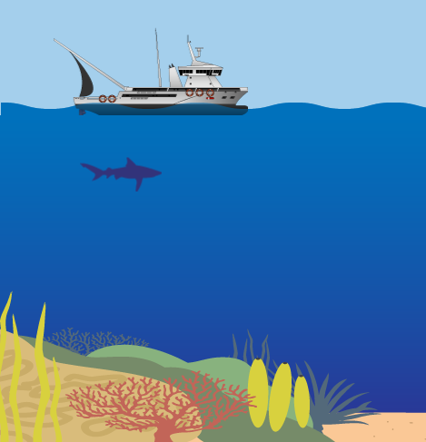
NASA – key stage 2
Coral Bleaching | NASA Climate Kids
Explore negative and positive numbers in sea temperatures
What do all these graphs mean? | NASA Climate Kids
Learning about the interpretation of statistics and data handling
How Do We Measure Sea Level? | NASA Climate Kids
Learning about measurement in the environment
What Causes Air Pollution? | NASA Climate Kids
Short video and background about air pollution for Living Lab Project

Slide 36
Other resources for environmental maths
https://www.ncetm.org.uk/media/ii0hlzul/issue_30_primary_magazine.pdf - A collection of lesson ideas linking nature environments around the world to maths (includes polar regions, deserts, mountains, city and rainforests) – cross-curricular links to Geography
What activities could you plan for your pupils based on these ideas?
Mathematics: The Winton Gallery | Science Museum
Links to architecture, aviation, Florence Nightingale, early measurement instruments (History) and opportunities for extra-curricular trips…

Slide 37
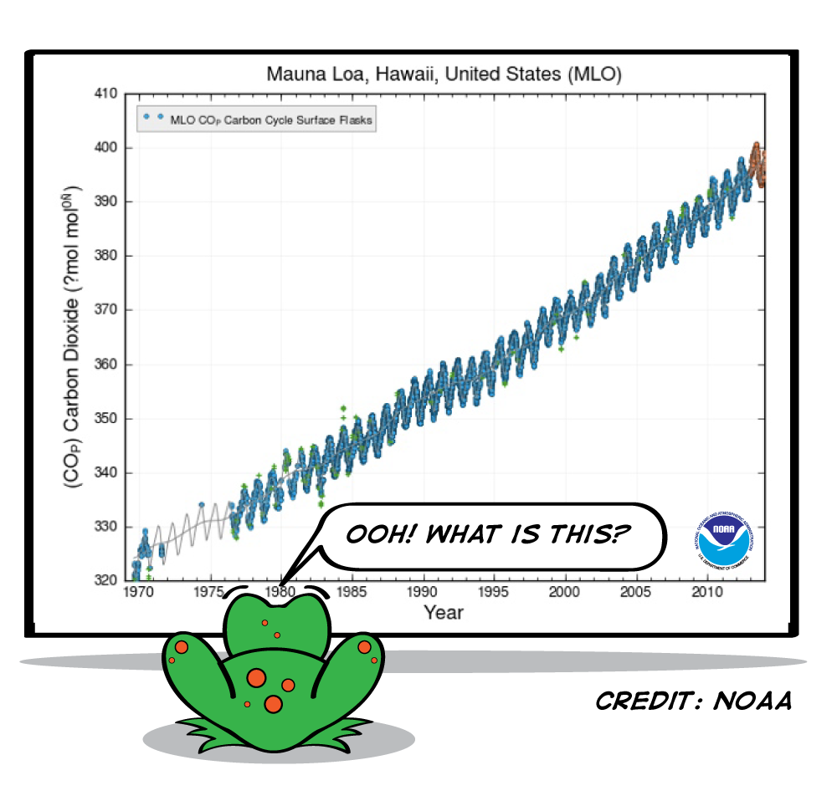
Your turn…
Apart from the resources shared with you today, you can refer back to the links in the lecture (materials on Moodle) to create your lesson activities for children in this session.
Select three or four resources, or find your own for inspiration, to create lesson ideas to use in placement schools.
You will an opportunity at the end of today’s session, to share your group’s ideas with us.

Slide 38
Cross-curricular links…
Ramanujan was “a mathematician of the highest quality, a man of altogether exceptional originality and power”
Art: Shape, Space and Measure – symmetry, tessellations, geometry, architecture; Roman Mosaics, famous artists – Klee, Kandinsky, MC Escher, African art patterns
Geography: land acres / hectares; population density; climate change
Cooking: recipe ingredients from around the world; measures – metric and imperial
Physical Education: Olympics and Paralympics; time, speed, distance in sports; areas of pitches; angles in rugby tries, football scoring and snooker shots.
Literacy and English: origins of number systems; poetry and mnemonics.
History: time lines, dates, decades, centuries and millenia
Modern Foreign Languages: numerals in different languages; length of words, for example, Chinese.
Music: rhythms, octaves, bars and chords; instruments and world music
Religious Education: pattern, symmetry, rotation and reflection in symbols, Islamic and Christian architecture.
Notes:
see social justice in the wider context, beyond mathematics, so that cross-curricular links can be made, and across primary and secondary courses

Slide 39
Work carried in primary schools
Academies they do not have to follow the national curriculum
Headteacher and leadership team are keen to diversify the curriculum
Children of students and staff at university, are from diverse backgrounds including Europe.
PHSE learning for life – recognising discrimination (Year 5); challenging stereotypes (Year 6)
Do you know how you would deal with racist incidents? Students’ experiences.

Slide 40
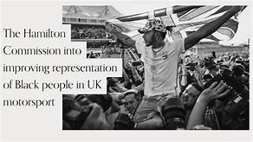
Primary curriculum
Little Amal – raising the profile of refugees around the world; University of Sanctuary
Pupils are children of university students and staff
Key stage 1 – extended family, relationships and different types of families; mixed heritage: Tinie Tempah, Emeli Sandé and other well-known Black Britons share their poignant, funny and emotional experiences of the conversations parents have to help their children face racism:
https://www.channel4.com/programmes/the-talk
Lower key stage 2 – what makes a community?
Diversity seen as a strength; different communities based on faith, clubs etc. What community groups are you involved in?
https://www.bbc.co.uk/sport/rugby-league/59385774
https://www.bera.ac.uk/blog/rethinking-how-we-can-improve-the-diversity-of-the-teaching-workforce-in-england
Anti-racism charter: Anti-racism charter | NEU
Notes:
Student teachers’ ideas from workshop…blues music – Little Richard and the Beatles, drama and theatre companies, English – writing a letter to Boris

Slide 41
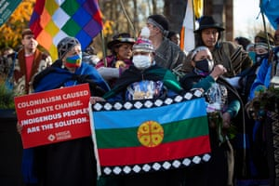
Moving forward: Shifting paradigms
1. Traditional knowledge – indigenous communities – course content
2. Afrofuturism – a reimagining of a future, abundant with arts, science, technology, history and sci-fi, through a Black lens
3. Lived experience – from our local communities in Yorkshire
4. Platforming – inviting visitors and guest speakers to sessions
Thank you for listening!
Notes:
Demolishing buildings wastes fossil fuels needed to make replacement new buildings; architects, engineers and construction companies working together to refurbish old buildings sustainably.

Slide 42
York St. John University Teacher Education Diversity and Inclusion conference (in association with Institute for Social Justice)
You are warmly invited to the first YSJ Teacher Education Diversity and Inclusion Conference which will take place on Monday 20 June at university. It is FREE to attend, with refreshments, and involve keynote speakers, students, staff, arts and community groups, local schools, and children, showcasing their work in anti-racist and decolonial practice. You are welcome to contribute projects, stories, poetry, music, dance, or song, on any of these themes by emailing Manjinder at m.jagdev@yorksj.ac.uk Thank you! We would love students and staff from across the university, and primary and secondary schools to join us to learn more about good classroom practice across the curriculum; book your tickets via the Eventbrite page: https://www.eventbrite.co.uk/e/ysj-teacher-education-diversity-and-inclusion-conference-tickets-267372898537?aff=InternalComms
CONFIRMED SPEAKERS
Dr. Gurnam Singh ‘From intelligence to wisdom: the need of age’ - Associate Professor of Equity, Office of Teaching and Learning, Coventry University
Professor Avtar Matharu ‘Decolonisation of research project with postgraduate students’ - Director of Green Chemistry Centre, University of York
Tony Cotton ‘Social Justice, Anti-racism or decolonising the curriculum. A reflection through 3 mathematical activities’ - Associate Professor, Social Justice in education, University of Nottingham, Editor - Mathematics Teaching and author of Understanding and Teaching Primary Mathematics.
Dr. Ipek Demir ‘Decolonising Research and Teaching: We want epistemic justice, not just diversity managerialism - Associate Professor, Director Centre for Ethnicity and Racism Studies, University of Leeds
Ashish Kundi ‘Teacher consciousness’ - Bridlington High school
Maxine Squire Assistant Director of Education and Skills, City of York Council
Jake Furby and Haddy Njie - Speak Up Diversity
Mary Owoo and Jess Hart – IVE Leeds Heritage Corner

Slide 43
Recommended reading to learn about anti-racism
Americanah by Chimamanda Ngozi Adichie
Barracoon: The Story of The Last Slave by Zora Neale Hurston
Beloved by Toni Morrison
Biased by Dr Jennifer Eberhardt
Diversify by June Sarpong
Don't Touch My Hair by Emma Dabiri
Freedom Is A Constant Struggle by Angela Davis
Girl, Woman, Other by Bernardine Evaristo
Hood Feminism by Mikki Kendall
How to Argue with a Racist by Adam Rutherford
How to Be an Anti-Racist by Ibram X. Kendi
I Am Not Your Baby Mother by Candice Brathwaite
Inglorious Empire: What the British Did to India by Shashi Tharoor

Slide 44
…continued…
Me and White Supremacy by Layla F. Saad
More than Enough by Elaine Welteroth
Overcoming Everyday Racism by Susan Cousins
Queenie by Candice Carty-Williams
Race Talk and the Conspiracy of Silence by Derald Wing Sue
Seeing Race Again by Kimberlé Williams Crenshaw et al.
Slay in Your Lane by Yomi Adegoke and Elizabeth Uviebinené
So You Want To Talk About Race by Ijeoma Oluo
Such a Fun Age by Kiley Reid
Superior: The Return of Race Science by Angela Saini
The Good Immigrant by Nikesh Shukla
The New Jim Crow: Mass Incarceration in The Age of Colorblindness by Michelle Alexander
Think Like a White Man by Boule Whytelaw and Nels Abbey
What Does It Mean to Be White? Developing White Racial Literacy by Robin DiAngelo
When They Call You A Terrorist by Patrisse Khan-Cullors and Asha Bandele
White Privilege by Kalwant Bhopal
Why I’m No Longer Talking to White People About Race by Reni Eddo-Lodge
Your Silence Will Not Protect You by Audre Lorde

Slide 45
More resources and references
BBC Sounds: Indigenous in Brazil say palm oil pesticides making them sick
Carbon Targets: https://www.carbontargets.uk/
CLIMATE LEARNING UCU - https://ctlw.web.ucu.org.uk/
Deer, M. (2020) Promoting Equality and Diversity in the Classroom [online]. https://cpdonline.co.uk/knowledge-base/safeguarding/promoting-equality-and-diversity-in-the-classroom/
Education international– Teach for the Planet: https://www.teach4theplanet.org/
ESD Changemakers - https://www.sos-uk.org/project/education-for-sustainable-development-changemakers
Kumar, S. and Cenkl, P. (2021) Transformative learning
Invest for Change, a campaign for university money to act in the interest of students, not against them
Merriam-Webster (2009) Definition of DIVERSITY [online]. https://www.merriam-webster.com/dictionary/diversity
NUS Decolonise library: https://www.nus.org.uk/campaigns/decolonise-education/mixed-media-library
Racism and Climate (In)Justice | Heinrich Böll Stiftung | Washington, DC Office - USA, Canada, Global Dialogue
TED talk, Kimberlé Crenshaw, The urgency of intersectionality
The Headteacher (n.d.) Diversity in schools – How to diversify your curriculum | Attainment and Assessment. [online]. https://www.theheadteacher.com/attainment-and-assessment/teaching-practice/how-to-diversify-your-curriculum
UCU Green New Deal
Urgency in climate change advocacy is backfiring, says Citizen Potawatomi Nation scientist
Why Using Afrofuturism in Environmental Education Excites Me
Yussuf, B. (2021). Diversity within the curriculum. Education in Science, p. 10.
Notes:
Thank you and hold on to optimism!

