Slide 1
The Ethics of Mathematics and Mathematics in Society
Paul Ernest
University of Exeter, UK
AMET webinar 24th February 2021

Slide 2
How does Ethics enter into Maths?
Ethics concerned with good and human flourishing affects the following aspects of mathematics and mathematical practice at least:
Professional ethics of mathematicians -- Do mathematicians behave well (and honestly) to each other in research and towards other persons in society?
Professional ethics of mathematics teachers - Do mathematics teachers treat their students well? Do they do what is best for them? Is the teaching of mathematics beneficial or harmful or both?
Ethics of mathematical applications – What are or should be the ethical limits of mathematical applications to ensure the good for society?
Ethical impact of mathematics on society – What further ethical impacts does the role and valuation of mathematics in society have, especially unplanned or hidden consequences?
Ethics of pure mathematics – What ethical values does pure mathematics incorporate or embody, if any?
For some mathematicians and philosophers the claim that pure mathematics is ethics- or value-laden is problematic ab initio.

Slide 3
Is Mathematics Ethics and Value Free?
Answer depends on philosophy chosen
1. Objectivist position: mathematical knowledge objective, universal, superhuman - untouched by human values or ethics.
Although legitimate, this position has problems. Most concede:
Mathematical concepts (including Natural numbers) are human inventions
Proof standards change so cannot depend on timeless fixed logical principles
2. Social constructivist or humanistic position - self evident that mathematics is value laden including ethics – because it is human product
However, can discern ethical elements in pure mathematics without resort to position 2.

Slide 4
Pure Mathematics and the Good
My claim - pure mathematics embodies aspects of the good.
Validity in maths requires display of means of verification (proof, calculation) publicly and openly. Thus mathematics embodies the ethical values of openness and democracy
Mathematics grows through pure research -- for its own sake -- based on working mathematicians’ virtuosity. Growth of knowledge and culture improves human flourishing and is thus intrinsically good. Thus mathematicians’ virtuosity is indeed a virtue.

Slide 5
The Ethics of Mathematics in Society
The ethics of mathematics in society is problematic because of the ubiquity of mathematics in governance, science, information and communication technologies, finance and education.
GOOD IMPACTS
mathematics is a great tool that enables the rich material basis for modern life. Almost all live healthier more comfortable lives because of maths and the science and technology it supports
NEGATIVE IMPACTS
Unethical applications. Many can be cited, e.g., in the news: Cambridge Analytica privacy intrusion and data mining to influence politics and subvert democracy.
Gross overvaluation of mathematics in modern society harmful

Slide 6
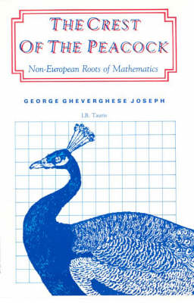
Mathematics is Overvalued in Society!
The claim that mathematics is grossly overvalued in modern society may be shocking for mathematicians and teachers!
We are insiders who love mathematics for its precision, power, universality, beauty, simplicity and complexity! Mathematics rightly claims to be the crowning glory of human knowledge – the crest of the peacock →
But not everybody shares our love or happy experiences. Indeed we are a very small percent of the population!

Slide 7
How and Why is Maths Overvalued?
Ubiquity of maths in modern computerized society seen as reason everybody needs maths:
Society depends on maths → everybody needs maths
Maths is a central feature of rationality
Reason matters → Maths counts
The lifeblood of the modern world is money:
Money matters → Money is an application of maths → Mathematics matters
Modern business and government depend on utility
Utilitarianism depends on benefit (cost/profit) calculations (i.e. mathematical applications)

Slide 8
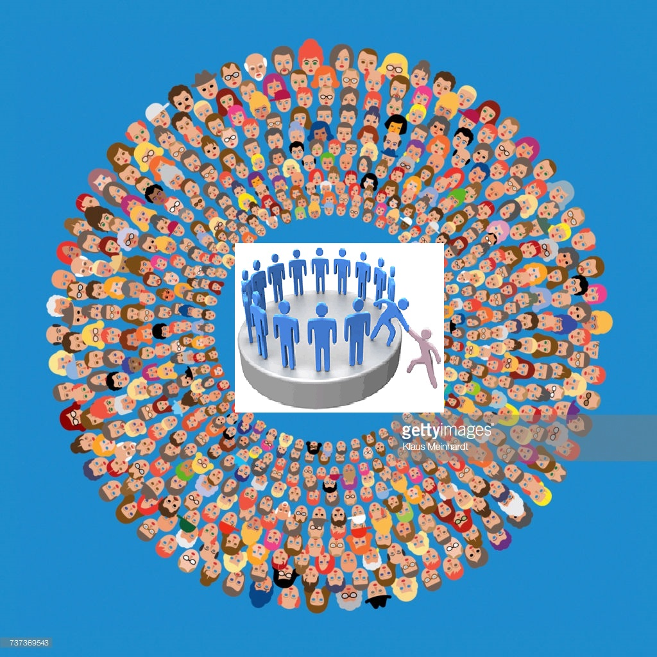
MATHEMATICS INSIDERS ARE A TINY MINORITY OF THE PUBLIC
> 99%
MATHS OUTSIDERS
THE PUBLIC
MATHS INSIDERS
< 1%

Slide 9
INSIDER VS. OUTSIDER VIEWS
MATHEMATICS INSIDERS
MATHS OUTSIDERS - PUBLIC
Mathematics is
Love object, Fascinating, Beautiful, Attractive
Meaningful, Useful, Powerful
Avenue to personal success
We are invested in it
For significant minority of public mathematics is
Meaningless, Joyless, Cold, Hard, Unforgiving, Masculine, Rejecting, Frightening
Inherited ability of others - not related to our efforts
Obstacle to advancement
They fear and avoid it
(Of course many of public also love or like maths)

Slide 10
Actual Mathematical Needs of Society
IMPOSED CHOICES
Maths PhD for mathematicians
Some further maths for work and study for many professions
(secondary school maths)
Numeracy plus for functioning critical citizens (primary school maths plus)
Advanced level maths for professional study, IT, Science
Maths degree for highly numerate professions
PERCENT NEEDED
OPTIONAL CHOICE
< 0.1%
OPTIONAL CHOICE
< 1%
OPTIONAL CHOICE
< 10%
100% MANDATORY
?? << 100%
100%
100% MANDATORY

Slide 11
EXCHANGE Vs USE VALUE OF MATHS
ACTUAL USE OF MATHS LIMITED (USE VALUE)
All need Numeracy plus – to be functioning critical citizens in democracy (primary school maths plus)
Society mathematized but most use algorithms in ICT, media, etc, without need of technical understanding
Tiny minority need to understand maths algorithms
SYMBOLIC USE OF MATHS (EXCHANGE VALUE)
Maths serves as a social filtration device. Maths certification is critical filter for entry to almost all higher education and professions
Many forced to study maths involuntarily suffer loss of self confidence, negative attitudes to maths
Classics: Same symbolic role as critical filter 16th-19thC

Slide 12
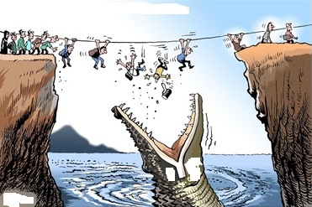
Maths Tests are a Critical Filter
STUDENTS OF MATHS
SUCCESS AT MATHS
MATHS TESTS
OVERALL
SUCCESS
WITH
IMPROVED
LIFE
CHANCES
CRITICAL FILTER
NOT JUST FAILURE BUT ALSO DAMAGE

Slide 13
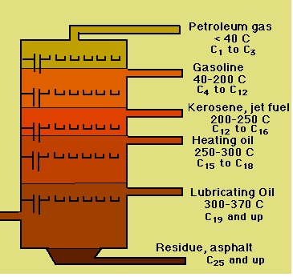
Maths provides Fractional Distillation
MATHEMATICS ASSESSMENT SYSTEM
→ PROFESSIONALS
SKILLED
WORKERS
UNSKILLED
WORKERS
CHILDREN →
UNEMPLOYED
UNDERCLASS
Mathematics success highly correlated with career outcomes
Success at maths should not be key arbiter of life chances

Slide 14
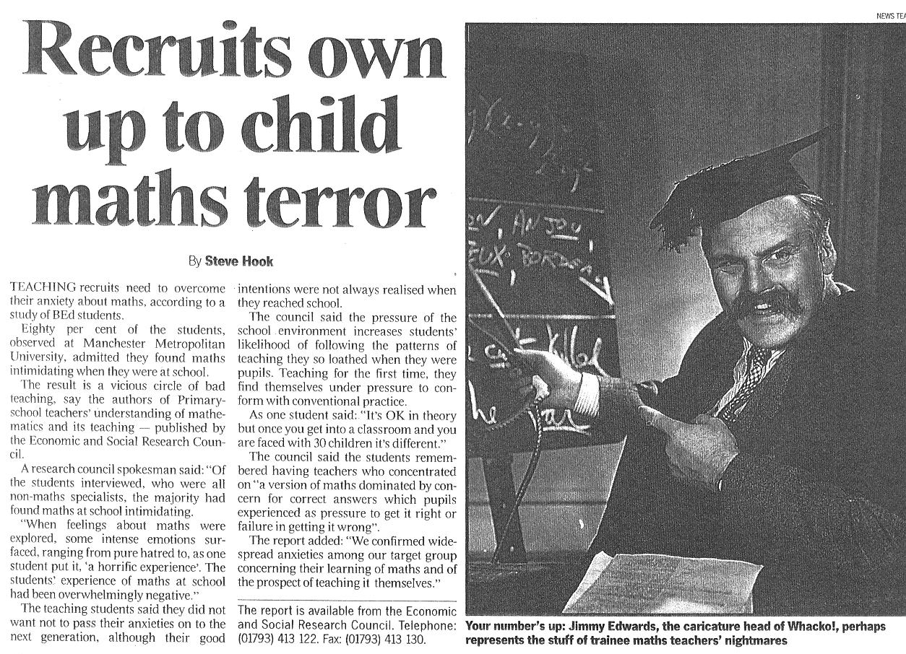
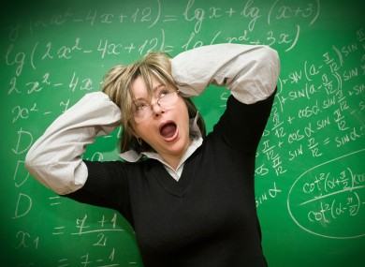
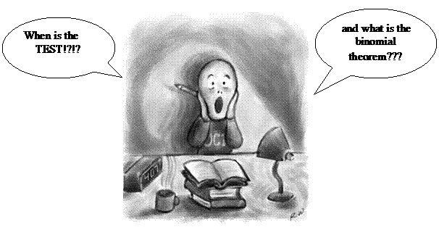
Social Cost: Negative Attitudes to Maths
Many learners and adults
Are labelled as maths failures
Lack confidence
Fear mathematics
Have reduced opportunities

Slide 15
We are Complicit in this Over-Valuing
We gain by not questioning the over-valuing of maths in society
Gain more resources, prestige, dominance in schooling
We accept uncritically argument that ubiquity in society maths means all must study abstract maths to 16 or 18
But we accept not everyone must study to 16 or 18 years
Arts, Literature, Drama, Psychology, Classics, Languages, Philosophy, Politics, Geography, History, Computing
Are these not equally important for personal development and work? But we leave them optional
Is maths failure learner fault or society’s fault for forcing it on everybody to 16 or 18 years?

Slide 16
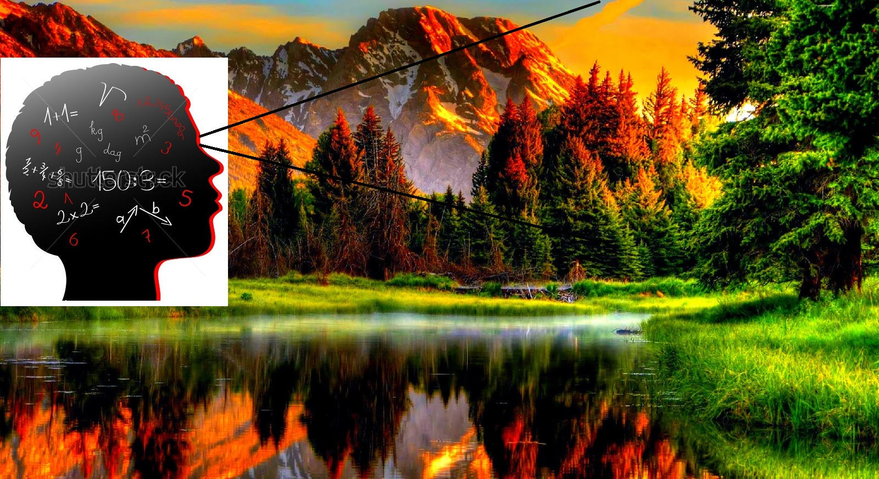
Seeing the world mathematically Replaces beautiful complexity of nature and the human worlds with simplified models

Slide 17
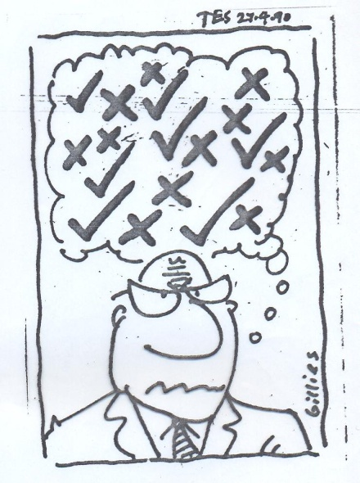
The Mathematical Way of Thinking
Promotes
Detachment of meaning, precise rule following
Reduction of complex situations to simple calculations/numerical models
Ethics-free technical reasoning
Separated values: Rules, Abstraction, Objectification, Reason, Dispassionate analysis, Impersonality (Gilligan 1982)
These valuable and intrinsic to maths. Applied across society can lead to ethical problems and abuses
Simplistic epistemology in which things are absolutely True or False
Training in ethics-free and value-free thinking - leads to ethical desensitisation & responsibility diminishment
Trains instrumental reasoning in management and business with focus only on means and away from ends or values
Separated values extended beyond maths imply it has no ethical or social responsibility

Slide 18
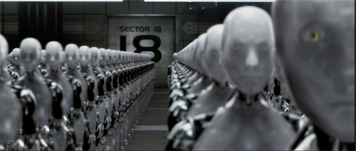
Dangers of instrumental reasoning
Mathematics is essence of instrumental reason - focus on means to ends and not on underlying values (Frankfurt School critique)
Instrumental reasoning underpins management, corporate and governmental thinking
Persons, animals, environment all viewed and treated as objects and mere resources – not as intrinsically valuable
Standardization, routinization, and dehumanization lead to unethical treatment of persons (Kelman 1973)
People are viewed as objects

Slide 19
Hidden Harm caused by Mathematics
Overvaluing mathematical qualifications blights lives of millions labeled as mathematical failures
Overvaluing Quantitative outlook supports managerialism & neoliberal performative agenda through privileging of measurement, accountability, and targets
Mathematical training can develops an ethics-free instrumentalist outlook that prioritises profit above any social costs -- powering exploitative corporativism and neoliberalism.
This is collateral damage – but we should acknowledge it and limit harm via teaching

Slide 20
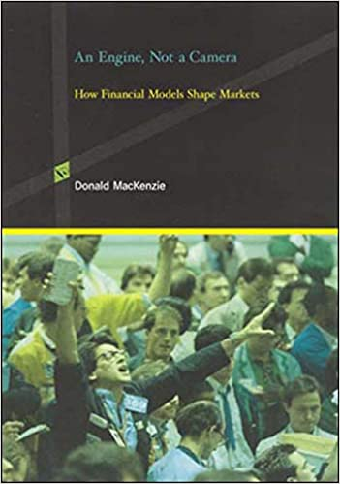
MacKenzie’s book (How financial models shape markets) identifies the performative work of maths

Slide 21
Mathematics is Performative
Mathematics is an engine not a mirror – rather than merely reflect society it changes it
When you apply measures of performance – you change the activities to meeting the targets – not to meeting the original goals
Schooling becomes about passing exams not learning flexible and adaptable skills
When business is all about the bottom line (profit)
The valuable service provided becomes secondary to profit
When welfare or health is all about meeting targets
Professionals forced to compromise their standards to meet targets
Maybe not yet in Norway – but certainly in USA and UK

Slide 22
Example: Victorian Payment by Results in British schools
MEASURES: No. Students & Results → Determine PAY
Payment by Results SYSTEM → CHANGES EDUCATION
Other perverse effects included inducing teachers, whose annual salaries were now tied to the numbers of pupils in their classes and to their performance at particular exams, to cheat. Teachers drilled their pupils mercilessly on test items (Hyndman, 1978: 34) once the inspector’s visit was imminent. Some secretly trained their pupils in classroom tricks that would create a more favourable impression. Yet others falsified enrolment registers, to keep numbers artificially high. Sick children were dragged along to school to satisfy attendance requirements, upon which teachers’ salaries were dependent (Hyndman, 1978: 37), while teachers now had to negotiate their salaries directly with school managers (Welch, 2007a).
Cramming, rather than teaching, became the means to ensure a teacher’s livelihood – weakening pupils, teachers, and pedagogy. Hence, a further product of the Revised Code was a narrowing of the curriculum and a narrow instrumentalism with respect to educational aims. Overall, while the scheme was justified by appeals to the principle of ‘efficiency’, it was in fact introduced largely as a means of curbing justifiable growth in state expenditure on education.
Anthony Welch, Mammon, Markets, and Managerialism, in R. Cowen and A. M. Kazamias (eds.), International Handbook of Comparative Education, Springer 2009, p 591.

Slide 23
How to correct or prevent such harm?
Overall harms comes from overvaluation and misapplication of Mathematical
How can we rectify this? (Through education)
Include philosophy of maths with mathematics
Teach the limits of mathematical knowledge - its certainties do not apply to the world – there is always a margin of error
Teach limits of mathematical thinking – true/false dichotomies do not apply to the world
Add the ethics of mathematics to maths courses
Teach the limits and dangers of instrumental thinking – it dehumanization of people and institutions
Mathematics must be applied responsibly or with awareness – it is wrong to ignore ‘incidental’ outcomes or ‘collateral damage’ in social impacts
Use ethical examples in teaching of mathematics
Use real world examples – Covid, Global warming, Pollution of the environment, Health and mortality figures from around the world, statistics on gender and race inequalities to show the impact of models, measures and mathematization

Slide 24
Reform Mathematics Teaching
Put less stress on examinations and testing
Give students maths course choices 11-16/18 years
Humanize mathematics teaching - duty of care for learners: their maths attitudes and images matter
Don’t demonize errors – they are inevitable steps in learning – not sins or failures
Teach critical thinking – look critically at social applications and mathematics-based claims
Add mathematical appreciation (<5%) to mathematical capability i.e. ‘doing maths’ (>95%)

Slide 25
Teach Appreciation of Maths
Maths more than calculating, solving and proving
At all levels taught maths must give a broader appreciation of
Maths in culture, art and social life
Impact of applications of maths on society and context
History of mathematics and maths in history
Proof and how maths knowledge validated – limits of mathematical certainty and applications
Controversies in philosophy of maths
Introduction of big ideas of mathematics
pattern, modelling, symmetry, structure, equivalence, invariance, proof, paradox, recursion, randomness, chaos, infinity, etc.
Critical citizenship through mathematics
Ethics of mathematical applications in society

Slide 26
Teach critical citizenship via maths
Mathematics should socially and politically empower students as numerate critical citizens in society to:
Critically understand uses of mathematics in society
Use maths in social and political activity, for betterment of students and democratic society as a whole
Interpret and critique uses of maths in social, commercial and political claims in adverts, headlines, blogs, reports, etc
Understand limits of validity of uses of maths, what decisions are concealed, and reject spurious or misleading claims
Scrutinize financial sector and government systems and procedures for objectivity, correctness and hidden assumptions
Address ethical implications of maths applications to balance instrumentalism, dehumanization and separated values
Every citizen needs these capabilities to defend democracy and values of humanistic and civilised society

Slide 27
Mathematics Specialists only one part of Surveillance State and Surveillance Capitalism – but an essential part
Business, Corporations
State, Government
Specialist Mathematicians
Surveillance Capitalism and State

Slide 28
Reaching the Other Parts of Society
If we can teach mathematicians to see mathematics as ethical, perhaps we can also teach future
Politicians and Government workers
Business leaders
to see mathematics as ethical in the long term, because they study in school too
If we teach all citizens to see mathematics as an ethical issue
Then we may be able to CURB THE EXCESSES of the Orwellian Surveillance State, Surveillance Capitalism and Politics manipulated via Data/Apps

Slide 29
Paul Ernest References on Maths and Ethics
Ernest, P. (2020) Mathematics, ethics and purism: an application of MacIntyre’s virtue theory. Synthese (2020). https://doi.org/10.1007/s11229-020-02928-1
Ernest, P. (2020) The ideologies of Purity and Neutrality and the Ethics of Mathematics. Philosophy of Mathematics Education Journal, No. 36 (December 2020).
Ernest, P. (2020) Unpicking the Meaning of the Deceptive Mathematics Behind the Covid Alert Levels. Philosophy of Mathematics Education Journal, No. 36 (December 2020).
Ernest, P. (2019) Privilege, Power and Performativity: The Ethics of Mathematics in Society and Education , Philosophy of Mathematics Education Journal, No. 35 (December 2019)
Ernest, P. (2019). The ethical obligations of the mathematics teacher. Journal of Pedagogical Research, 3(1), 80-91. doi: 10.33902/JPR.2019.6
Ernest, P. (2019). Ethics and the Mathematics Teacher, Part 1. Mathematics Teaching, April 2019, pp. 28-33.
Ernest, P. (2019) Ethics and the Mathematics Teacher 2, Mathematics Teaching
Ernest, P. (2019) A Theoretical Inquiry into the Ethics of Mathematics Teaching. Malikussaleh Journal of Mathematics Learning, Vol. 2, No. 2, October 2019, pp. 68-75.
Ernest, P. (2018) The Ethics of Mathematics, in P. Ernest, Ed. The Philosophy of Mathematics Education Today, Switzerland: Springer international. 2018.
Ernest, P. (2016) A Dialogue on the Ethics of Mathematics, The Mathematical Intelligencer Vol. 38, No. 3, pp. 69-77.; DOI:10.1007/s00283-016-9656-z
Ernest, P. (2016) Mathematics and Values. B. Larvor, Ed. Mathematical Cultures. Switzerland: Springer, 2016, pp. 189-214.
Ernest, P. (2016) Challenging Three Myths about Mathematics: Recognising the social responsibility of mathematics. P. Blaszczyk, Ed. Mathematical Transgressions.
Ernest, P. (2016) Values and Mathematics: Overt and Covert, Culture and Dialogue, Volume 4, No. 1 (special issue Culture, Science and Dialogue, Guest Editor: M. Ovens).
Ernest, P. (2016) The Collateral Damage of Learning Mathematics, Philosophy of Mathematics Education Journal, No. 31. Freely available online.
Ernest, P. (2012) ‘What is our First Philosophy in Mathematics Education?’, For the Learning of Mathematics, Vol. 32 no. 3: 8-14.
Ernest, P. (2009) 'Globalization, Ideology and Research in Mathematics Education’, Ernest, P. Greer, B, & Sriraman, B. Eds. (2009) Critical Issues in Mathematics Education, Charlotte, NC, USA: Information Age Publishing, 67-110.
Ernest, P. (2009) 'Values and the Social Responsibility of Mathematics’, Ernest, P. Greer, B, & Sriraman, B. Eds. (2009) Critical Issues in Mathematics Education, Charlotte, NC, USA: Information Age Publishing, 207-216.
Ernest, P. (1998) Social Constructivism as a Philosophy of Mathematics, Albany, New York: SUNY Press.
(Plus refs on social justice, race, gender, special needs, critical citizenship, empowerment and critique of objectivist and absolutist philosophies of mathematics)

